Slide 1

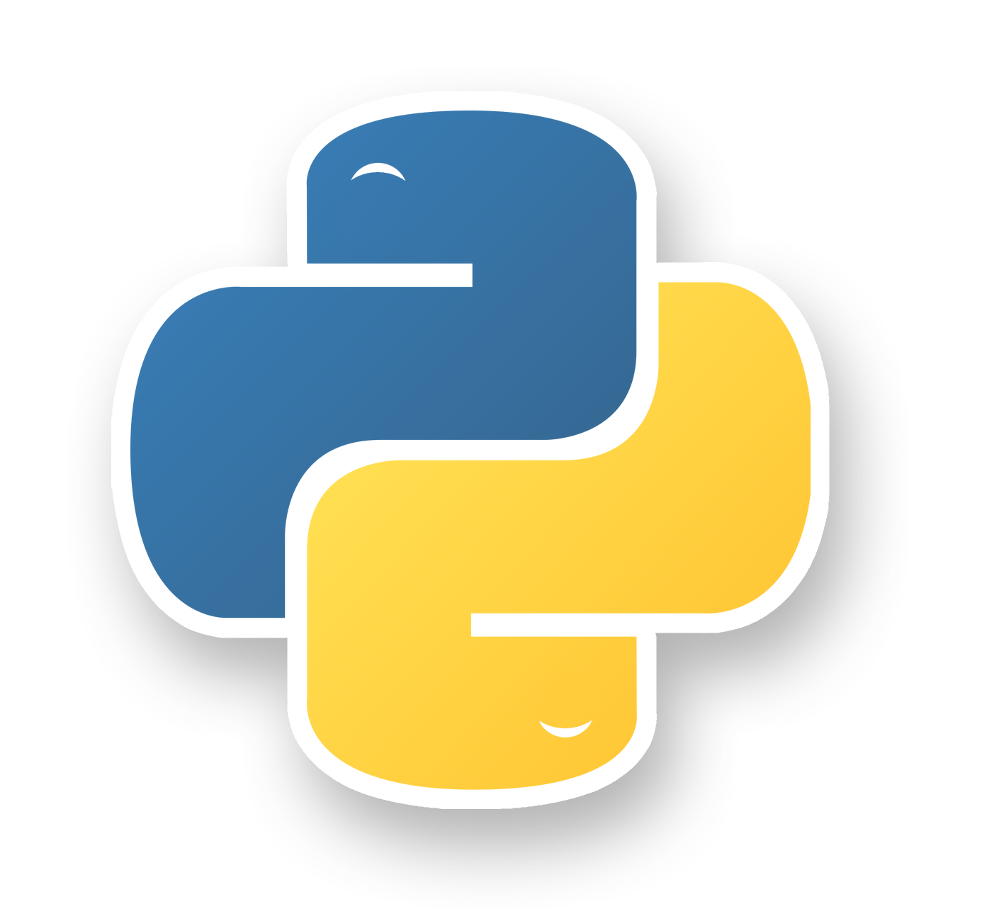



Data Collecting

Slide 2
Data Collection:
Is the process of collecting, measuring and analyzing different types of information using a set of standard validated techniques.
The main objective of data collection is to gather information-rich and reliable data and analyze them to make critical business decisions.
Once the data is collected, it goes through a rigorous process of data cleaning and data processing to make this data truly useful for businesses.

Slide 3
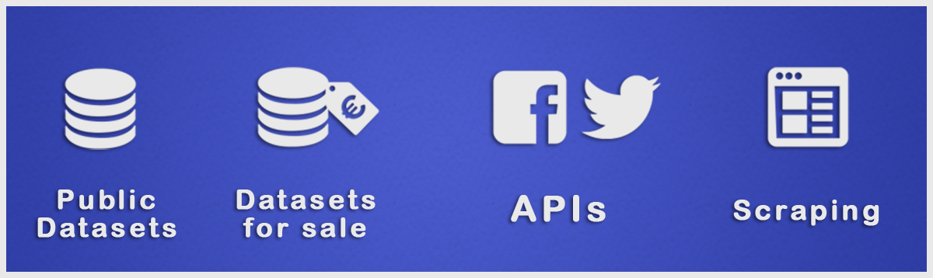
Data Collecting

Slide 4



Public Datasets
https://www.kaggle.com/datasets
http://archive.ics.uci.edu/ml/index.php
https://data.fivethirtyeight.com
https://github.com/BuzzFeedNews
https://opendata.socrata.com
https://cloud.google.com/bigquery/public-data
https://github.com/awesomedata/awesome-public-datasets
https://www.data.gov
http://academictorrents.com/browse.php
https://www.quandl.com/search
https://tinyletter.com/data-is-plural

Slide 5

Data Collecting
So What we do if there is
no datasets available ?!
We will learn about Web Scraping and Rest APIs web services

Slide 6
Agenda
What is Internet and Web Servers
HTTP Request/Response Cycle
REST API Web Services
Work with JSON
HTML
CSS
Scrapping Concept
BeautifulSoap Library

Slide 7
Agenda
What is Internet and Web Servers
HTTP Request/Response Cycle
REST API Web Services
Work with JSON
HTML
CSS
Scrapping Concept
BeautifulSoap Library

Slide 8
Web services are:
Is available over the Internet or private (intranet) networks
Is not tied to any one operating system or programming language
Is discoverable via a simple find mechanism

Slide 9
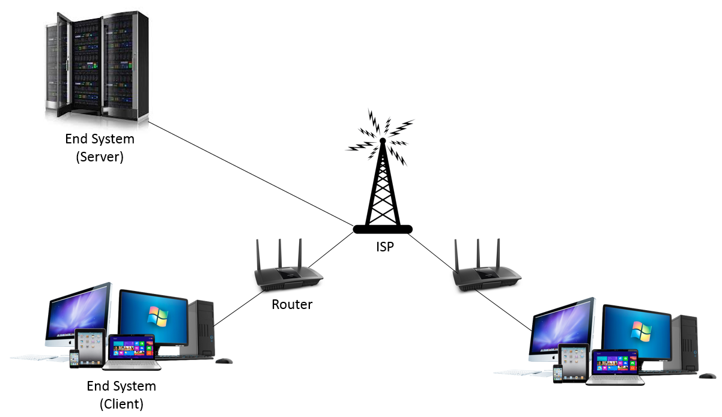
What is Internet and Web Servers

Slide 10
Agenda
What is Internet and Web Servers
HTTP Request/Response Cycle
REST API Web Services
Work with JSON
HTML
CSS
Scrapping Concept
BeautifulSoap Library

Slide 11
HTTP:
Hyper-text-transfer-protocol (HTTP) is a procedural system for fetching resources (for example, HTML documents) .
It is a client-server protocol, meaning requests are made by the recipient (typically the browser).
HTTP is the foundation for any data exchange made on the Web and is essentially the backbone of the internet.
From all the sub-documents fetched a complete document is reconstructed, including images, layout description, text, scripts, etc.

Slide 12
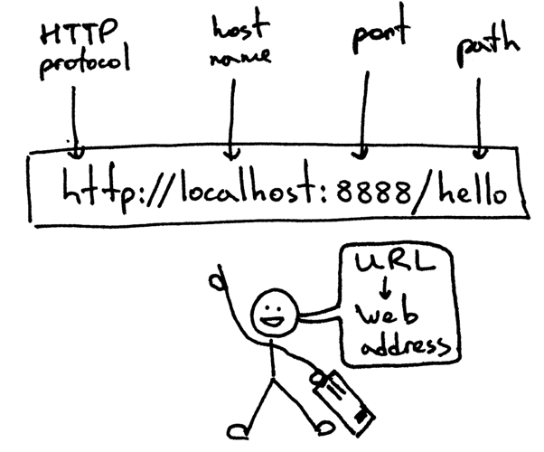
HTTP Request/Response Cycle

Slide 13
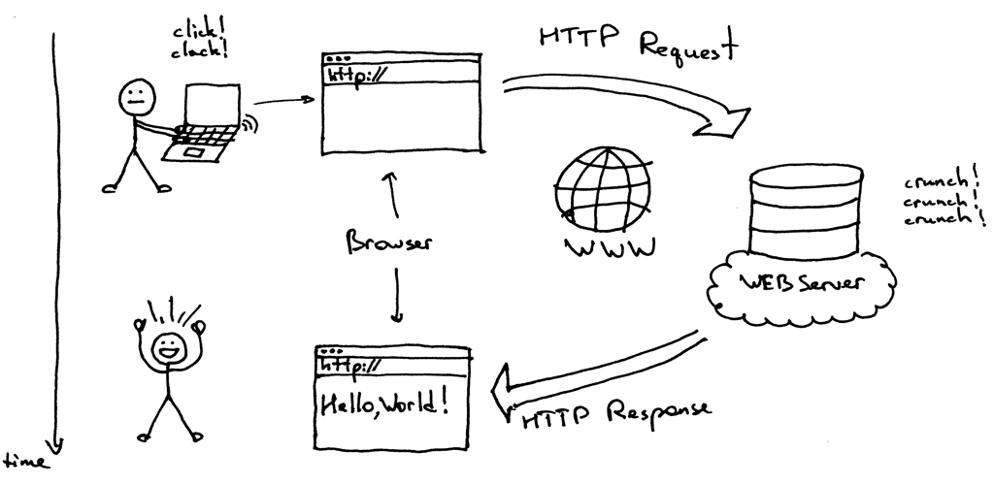
HTTP Request/Response Cycle

Slide 14
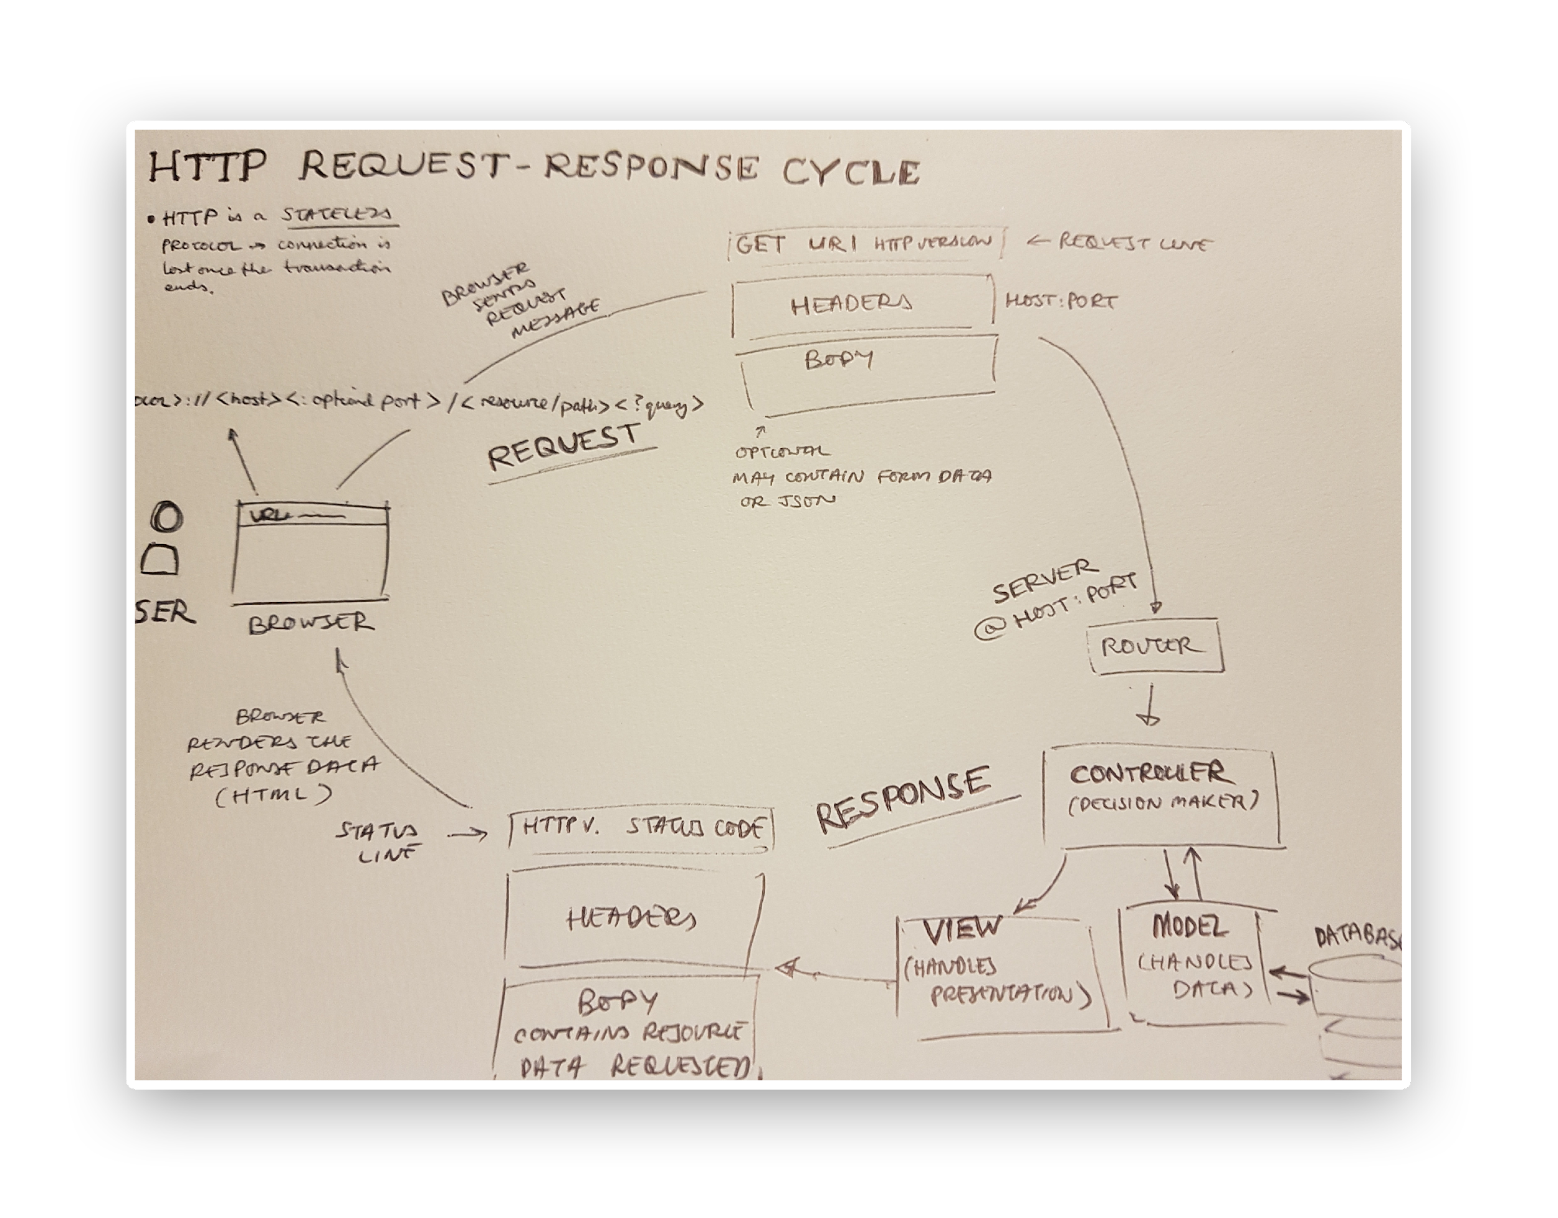

Slide 15
HTTP Requests
A HTTP request is a text string generated by the client and sent to the server containing the specifications of the resource the client is asking for.
A resource is anything that can accessed via the web.
The HTTP request communicates which resource a client wants to interact with and how the client wants to interact with it, along with some metadata held in the header related to the request.
The resource the client wants to interact with is communicated through the URL that is sent with the request.
For example, if a user entered http://twitter.com into their web browser, the web browser would send a request to the server looking for the Twitter resource.

Slide 16
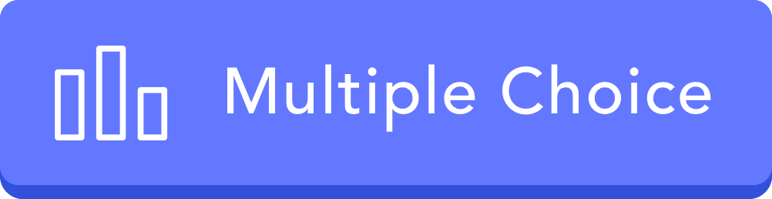
HTTP stands for:
Hyper text markup language.
Hyper text transfer protocol.
Hyper text translate protocol.
Higher text transfer protocol.

Slide 17
Agenda
What is Internet and Web Servers
HTTP Request/Response Cycle
REST API Web Services
Work with JSON
HTML
CSS
Scrapping Concept
BeautifulSoap Library

Slide 18
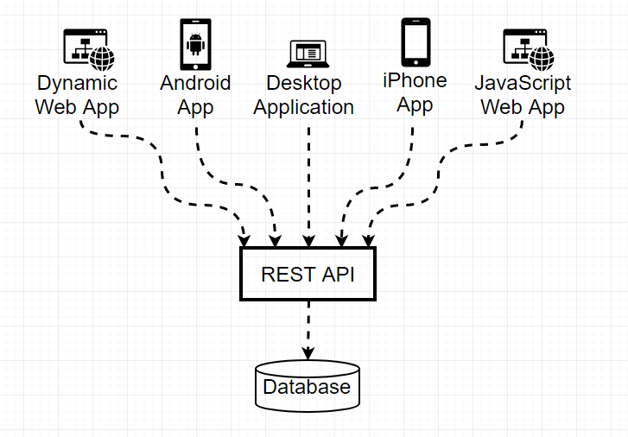
REST API Web Services
Have you ever asked how we connect to something like Facebook, Google, Amazon etc. and we can see our profiles or data ?!!
It’s all about API (Application Programing Interface)
We connect to the target and ask for API if exists, the API does the rest by retrieving data from database if allowed .
Modern APIs adhere to standards (typically HTTP and REST.
managing, and versioning.
Also, modern APIs are well documented for consumption and versioning.

Slide 19
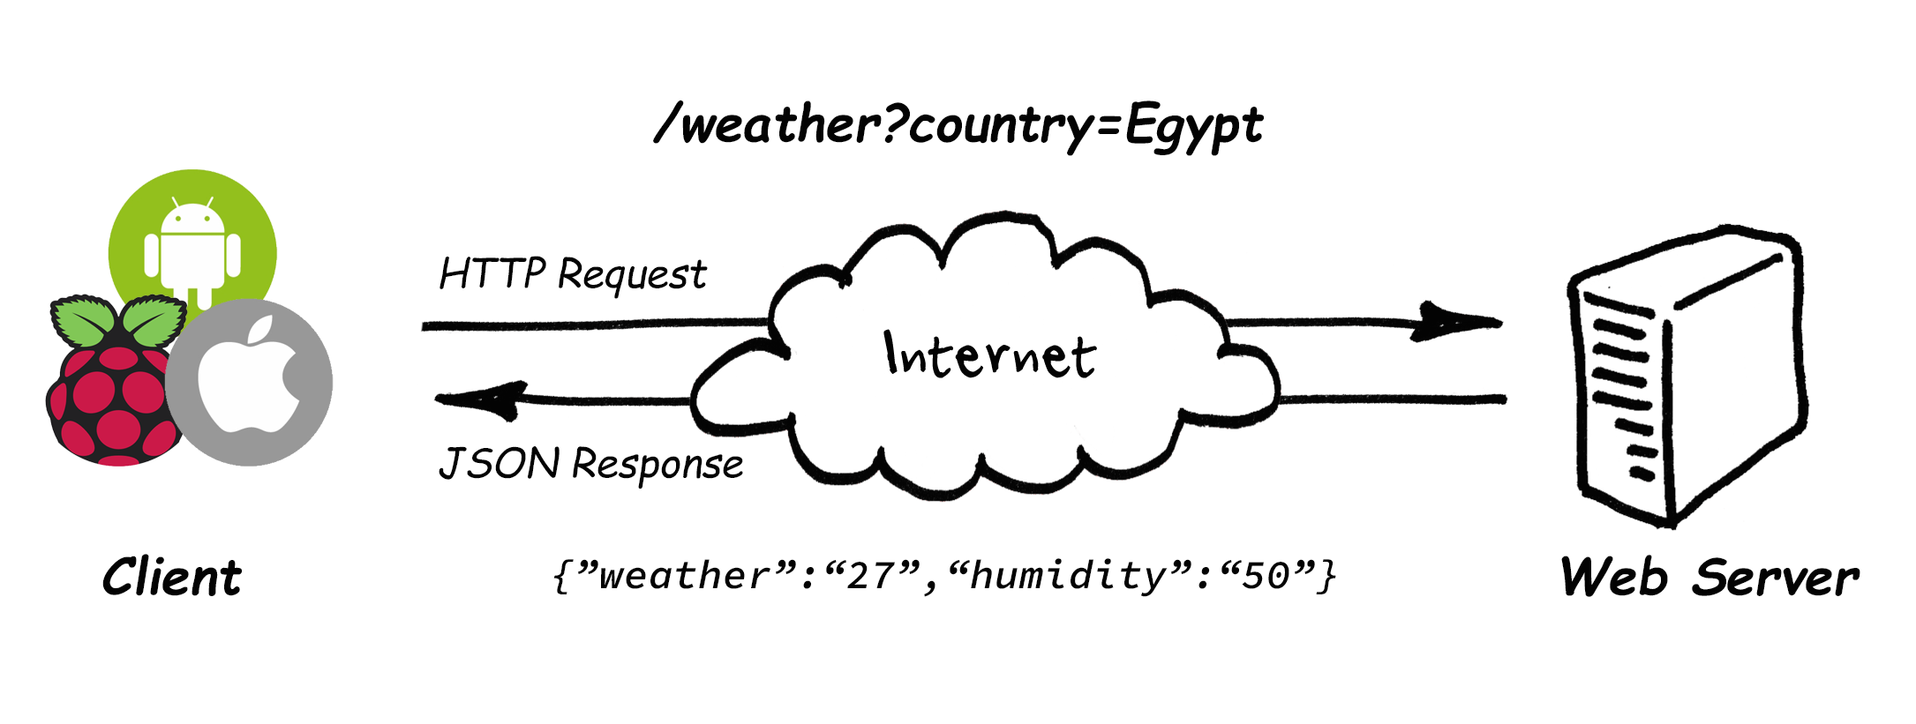
REST API Web Services
A good example for the API, if we want to know the weather of Egypt through a specific website. We connect to the website and ask for the API if exists and it does the rest

Slide 20
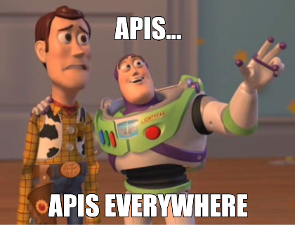
REST API Web Services
https://any-api.com/
https://github.com/public-apis/public-apis
…

Slide 21
Which of the following is correct about web services?
A - A web service is a collection of open protocols and standards used for exchanging data between applications or systems.
B - Software applications written in various programming languages and running on various platforms can use web services to exchange data among them over computer networks like the Internet.
C - Both above.
D - None of the above.

Slide 22
Agenda
What is Internet and Web Servers
HTTP Request/Response Cycle
REST API Web Services
Work with JSON
HTML
CSS
Scrapping Concept
BeautifulSoap Library

Slide 23
JSON:
JSON (JavaScript Object Notation) is a lightweight data-interchange format.
It is easy for humans to read and write. It is easy for machines to parse and generate.
JSON is a text format that is completely language independent but uses conventions that are familiar to programmers of the C-family of languages, including C, C++, C#, Java, JavaScript, Perl, Python, and many others.
These properties make JSON an ideal data-interchange language.
JSON is built on two structures:
A collection of name/value pairs. In various languages, this is realized as an object, record, struct, dictionary, hash table, keyed list, or associative array.
An ordered list of values. In most languages, this is realized as an array, vector, list, or sequence.

Slide 24
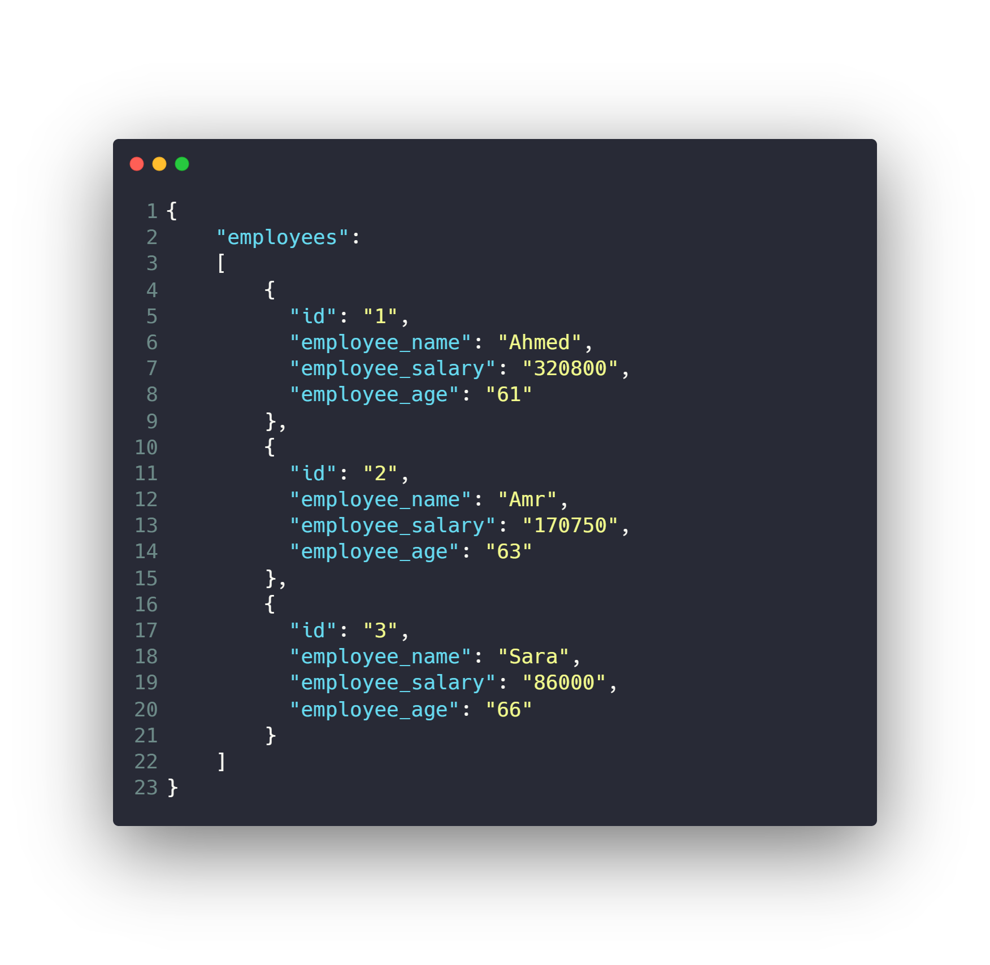
Work with JSON

Slide 25
Work with JSON
Install JSON Viewer extension
For chrome or firefox
https://chrome.google.com/webstore/detail/json-viewer/gbmdgpbipfallnflgajpaliibnhdgobh

Slide 26

Work with JSON
Or you can use Postman to work with
Web services
https://www.postman.com/

Slide 27
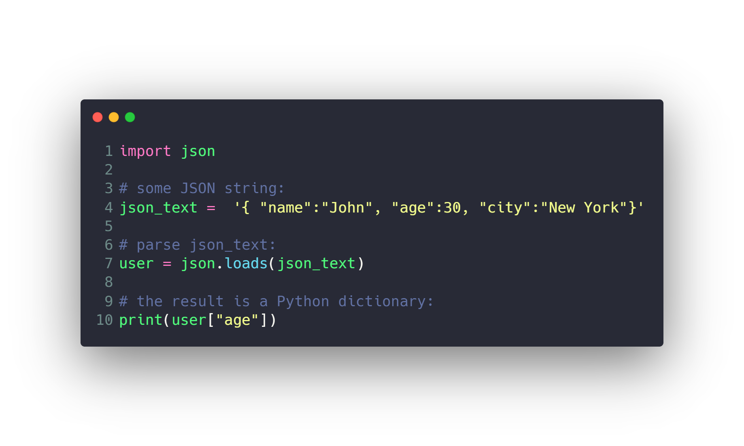
Work with JSON

Slide 28
8) What is the full form of JSON?
A. JavaScripts Object Notification.
B.JavaScript Object Notation.
C.None of these

Slide 29
Assignment Mandatory
1- Study HTML & CSS from this playlist before the next session
https://www.youtube.com/playlist?list=PLgGbWId6zgaWZkPFI4Sc9QXDmmOWa1v5F

Slide 30
Agenda
What is Internet and Web Servers
HTTP Request/Response Cycle
REST API Web Services
Work with JSON
HTML
CSS
Scrapping Concept
BeautifulSoap Library

Slide 31

HTML
Hyper Text Markup Language
Have you ever wondered what HTML is ?!
HTML is the standard markup language for documents designed to be displayed in a web browser, it provides means to create structured documents by denoting structural semantics for text such as headings, paragraphs, lists, links, quotes and other items.
Excited to know more !!! Let’s learn more about it

Slide 32
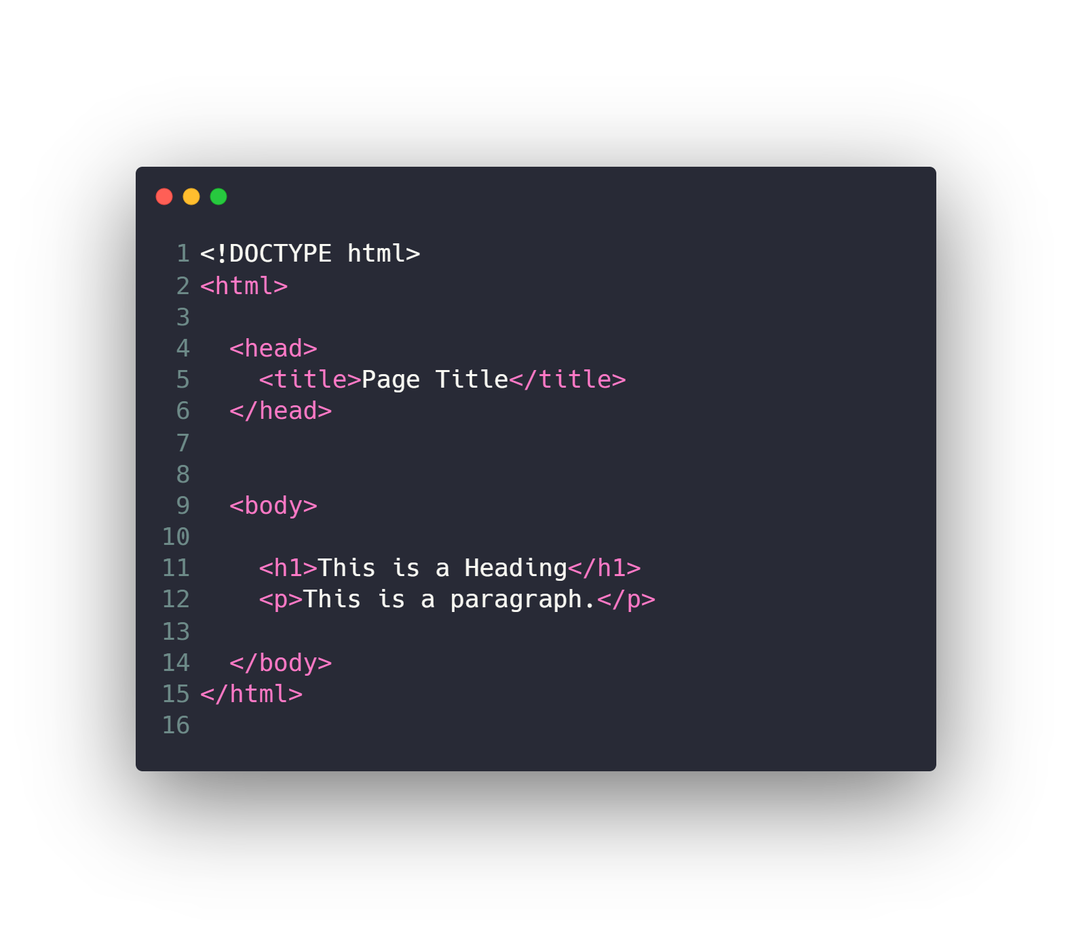
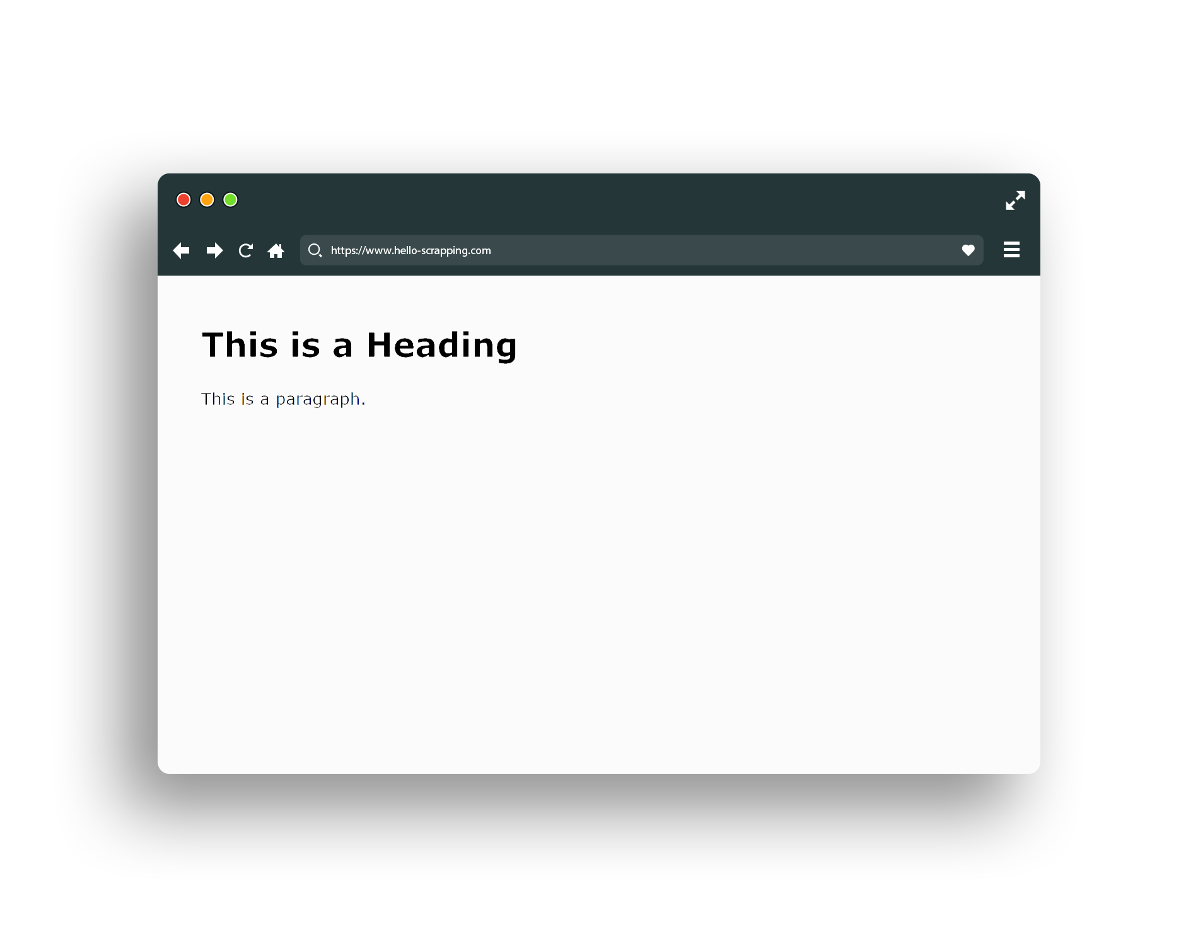
HTML (base snippet code)

Slide 33
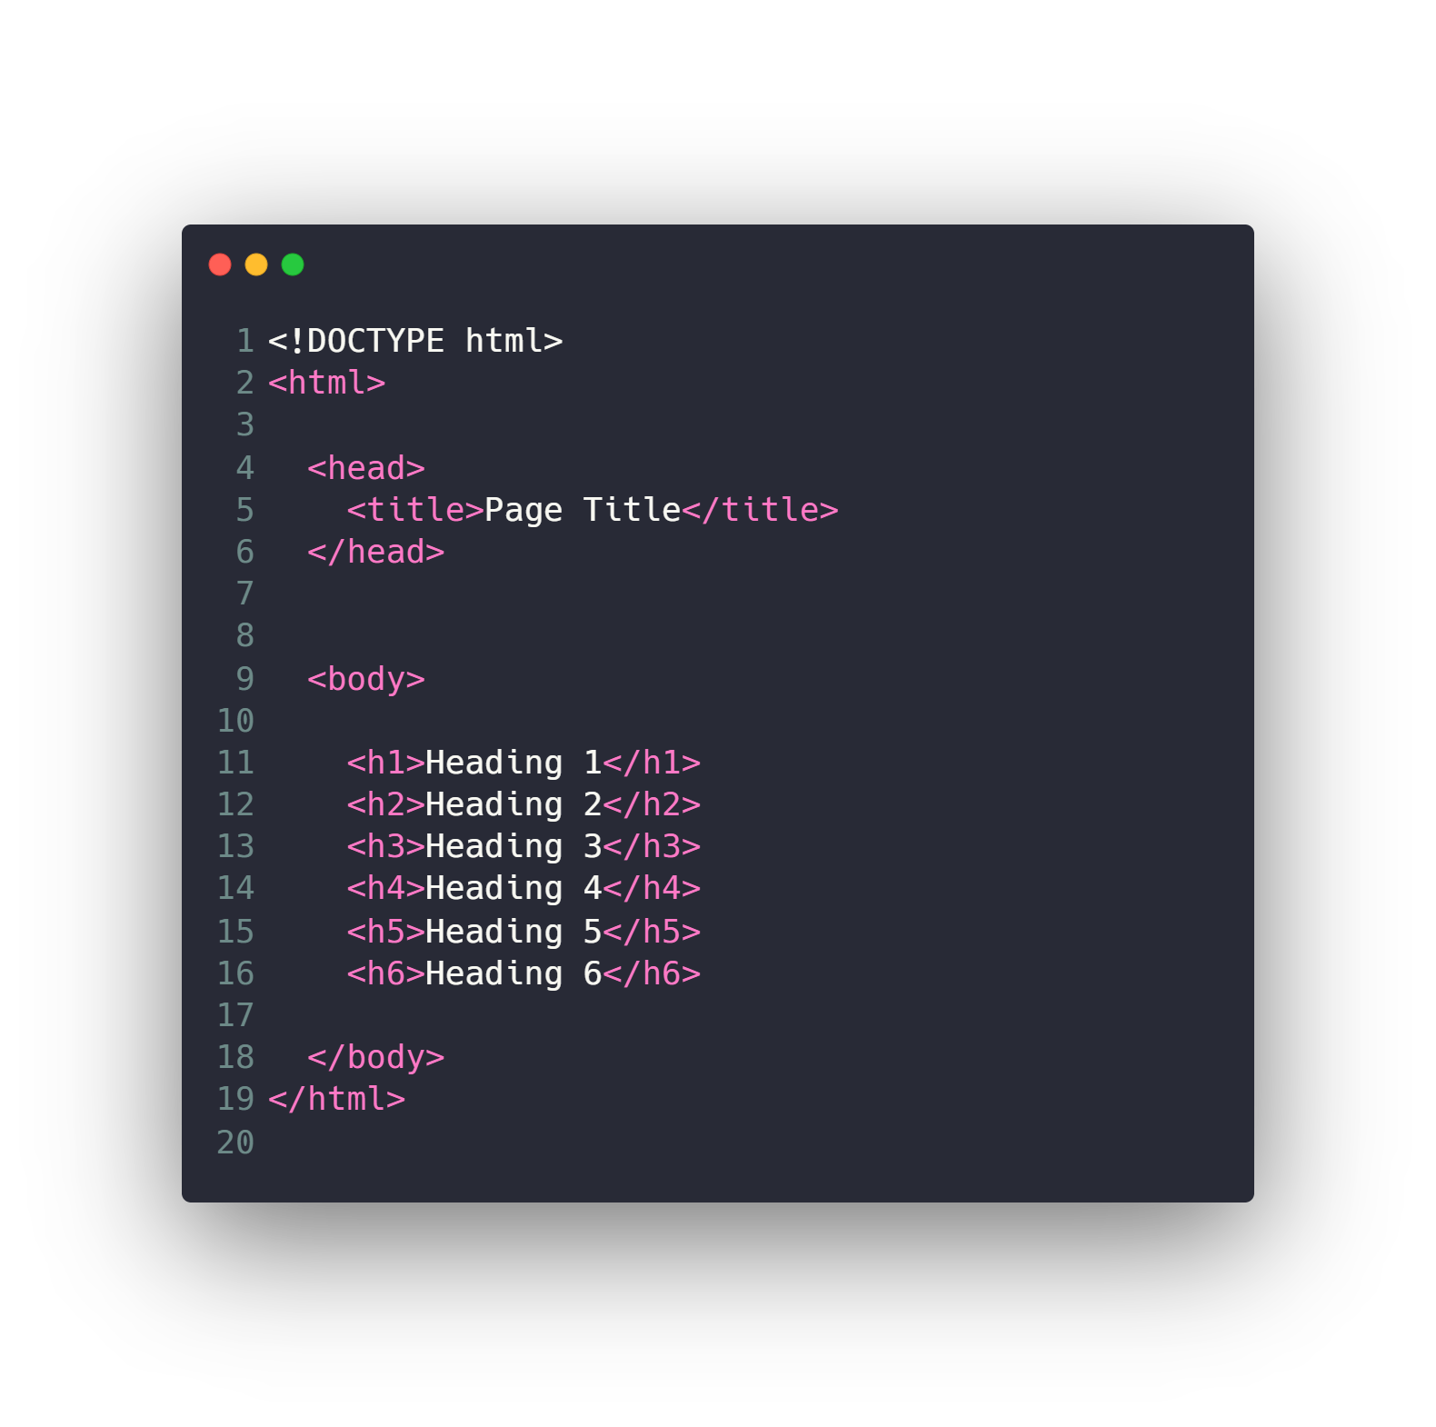
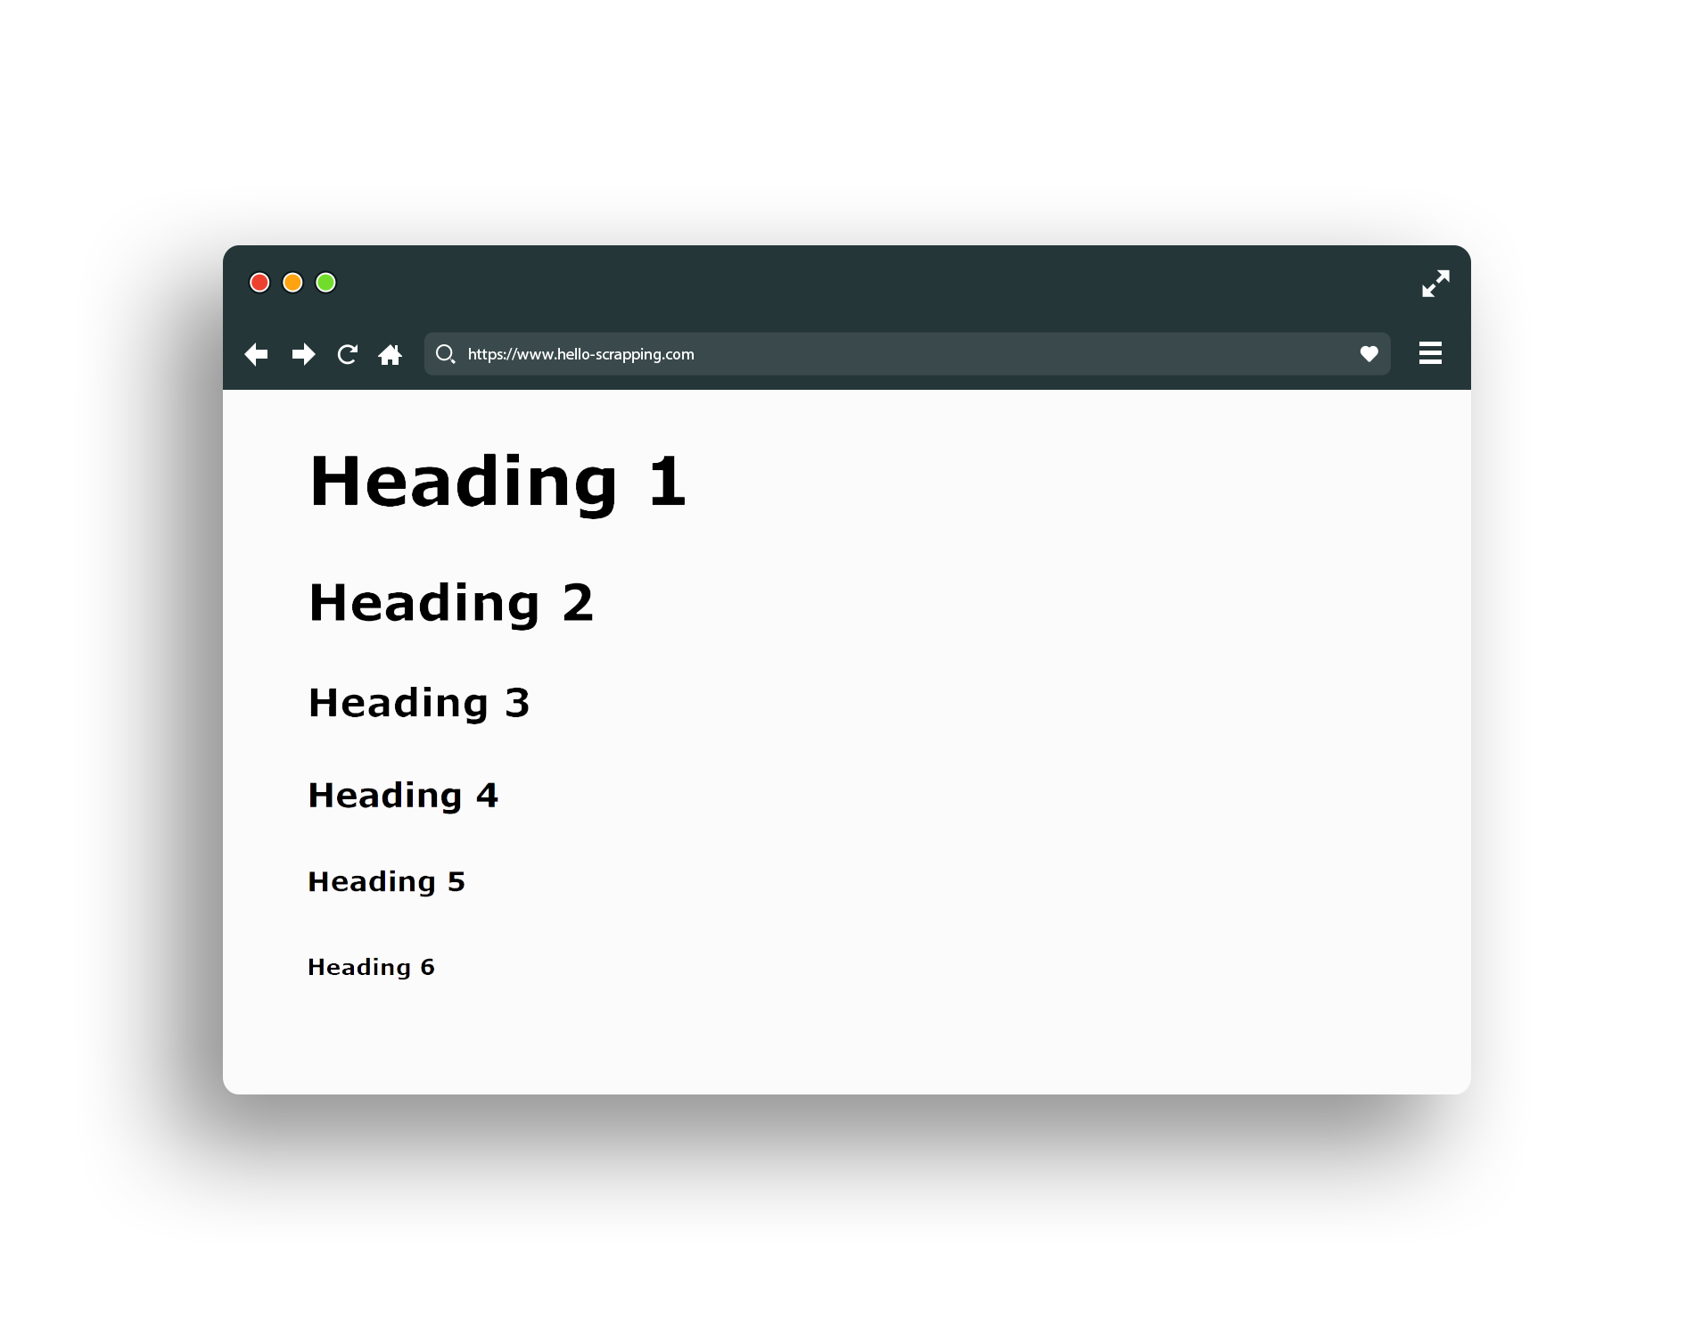
HTML (header)

Slide 34
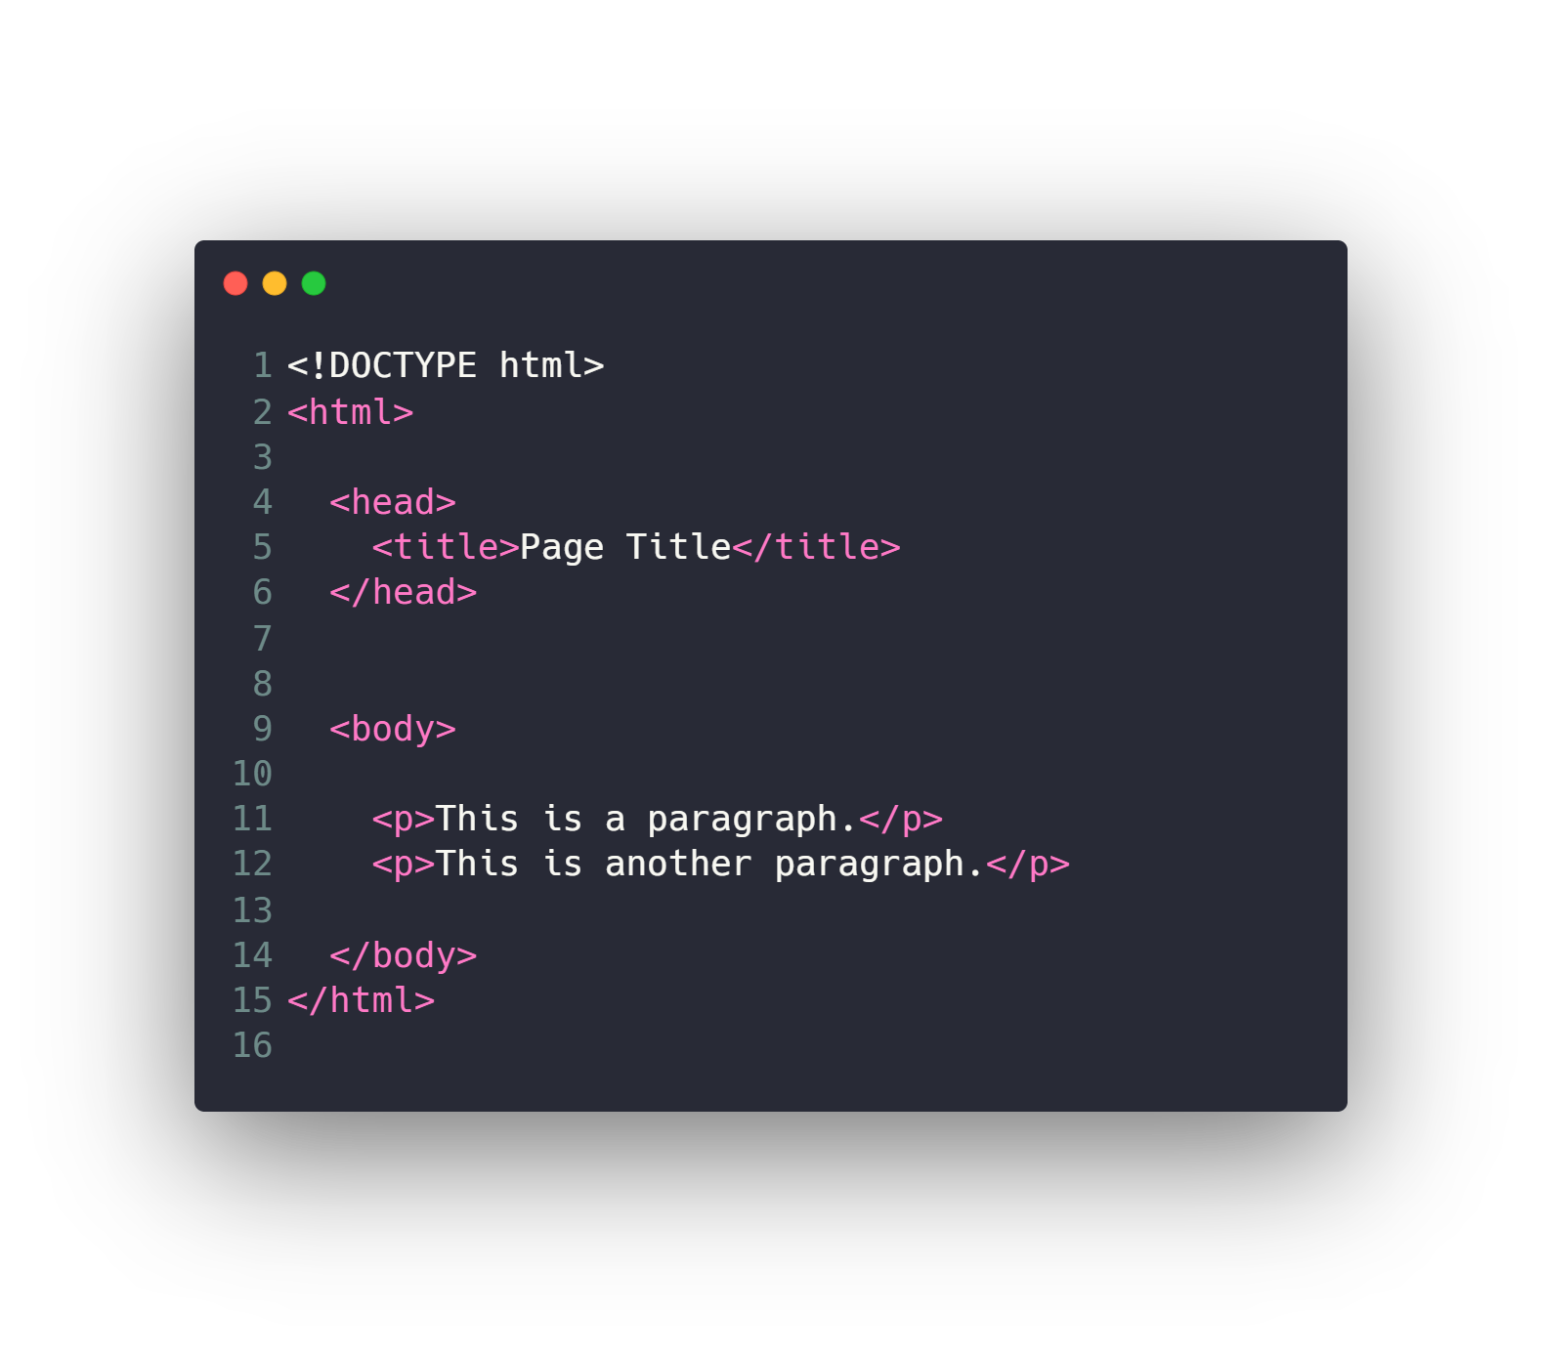
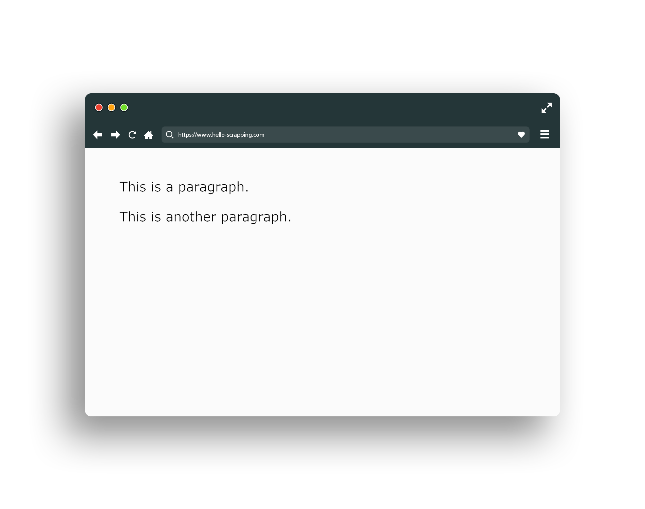
HTML (paragraph)

Slide 35
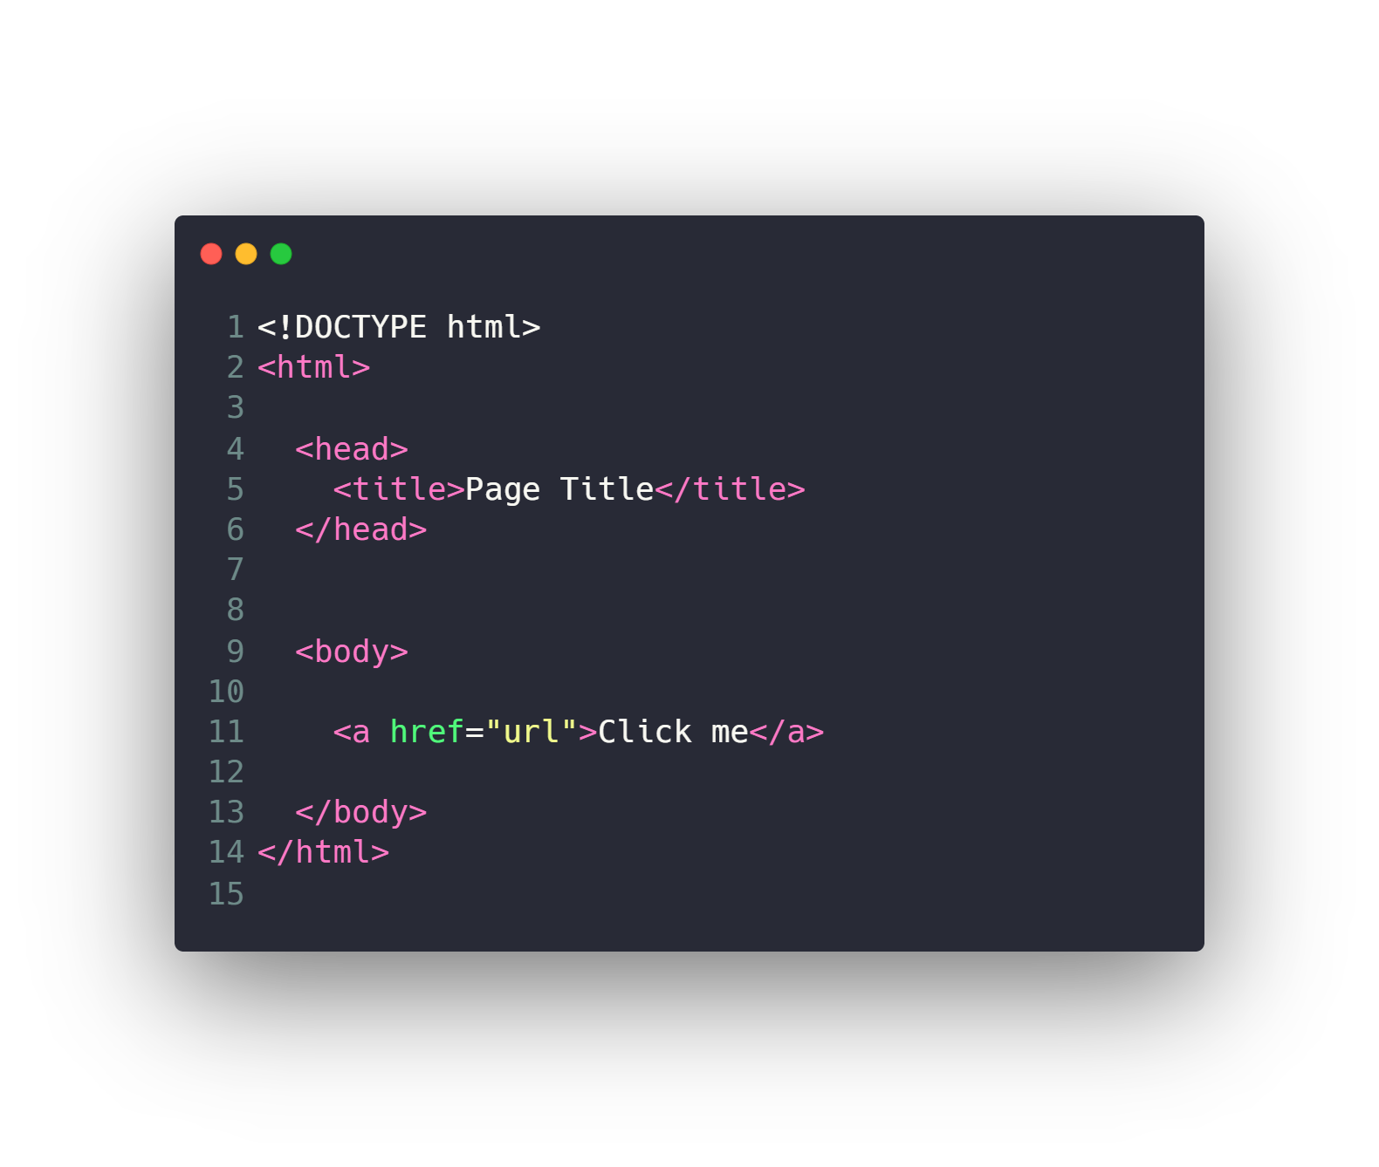
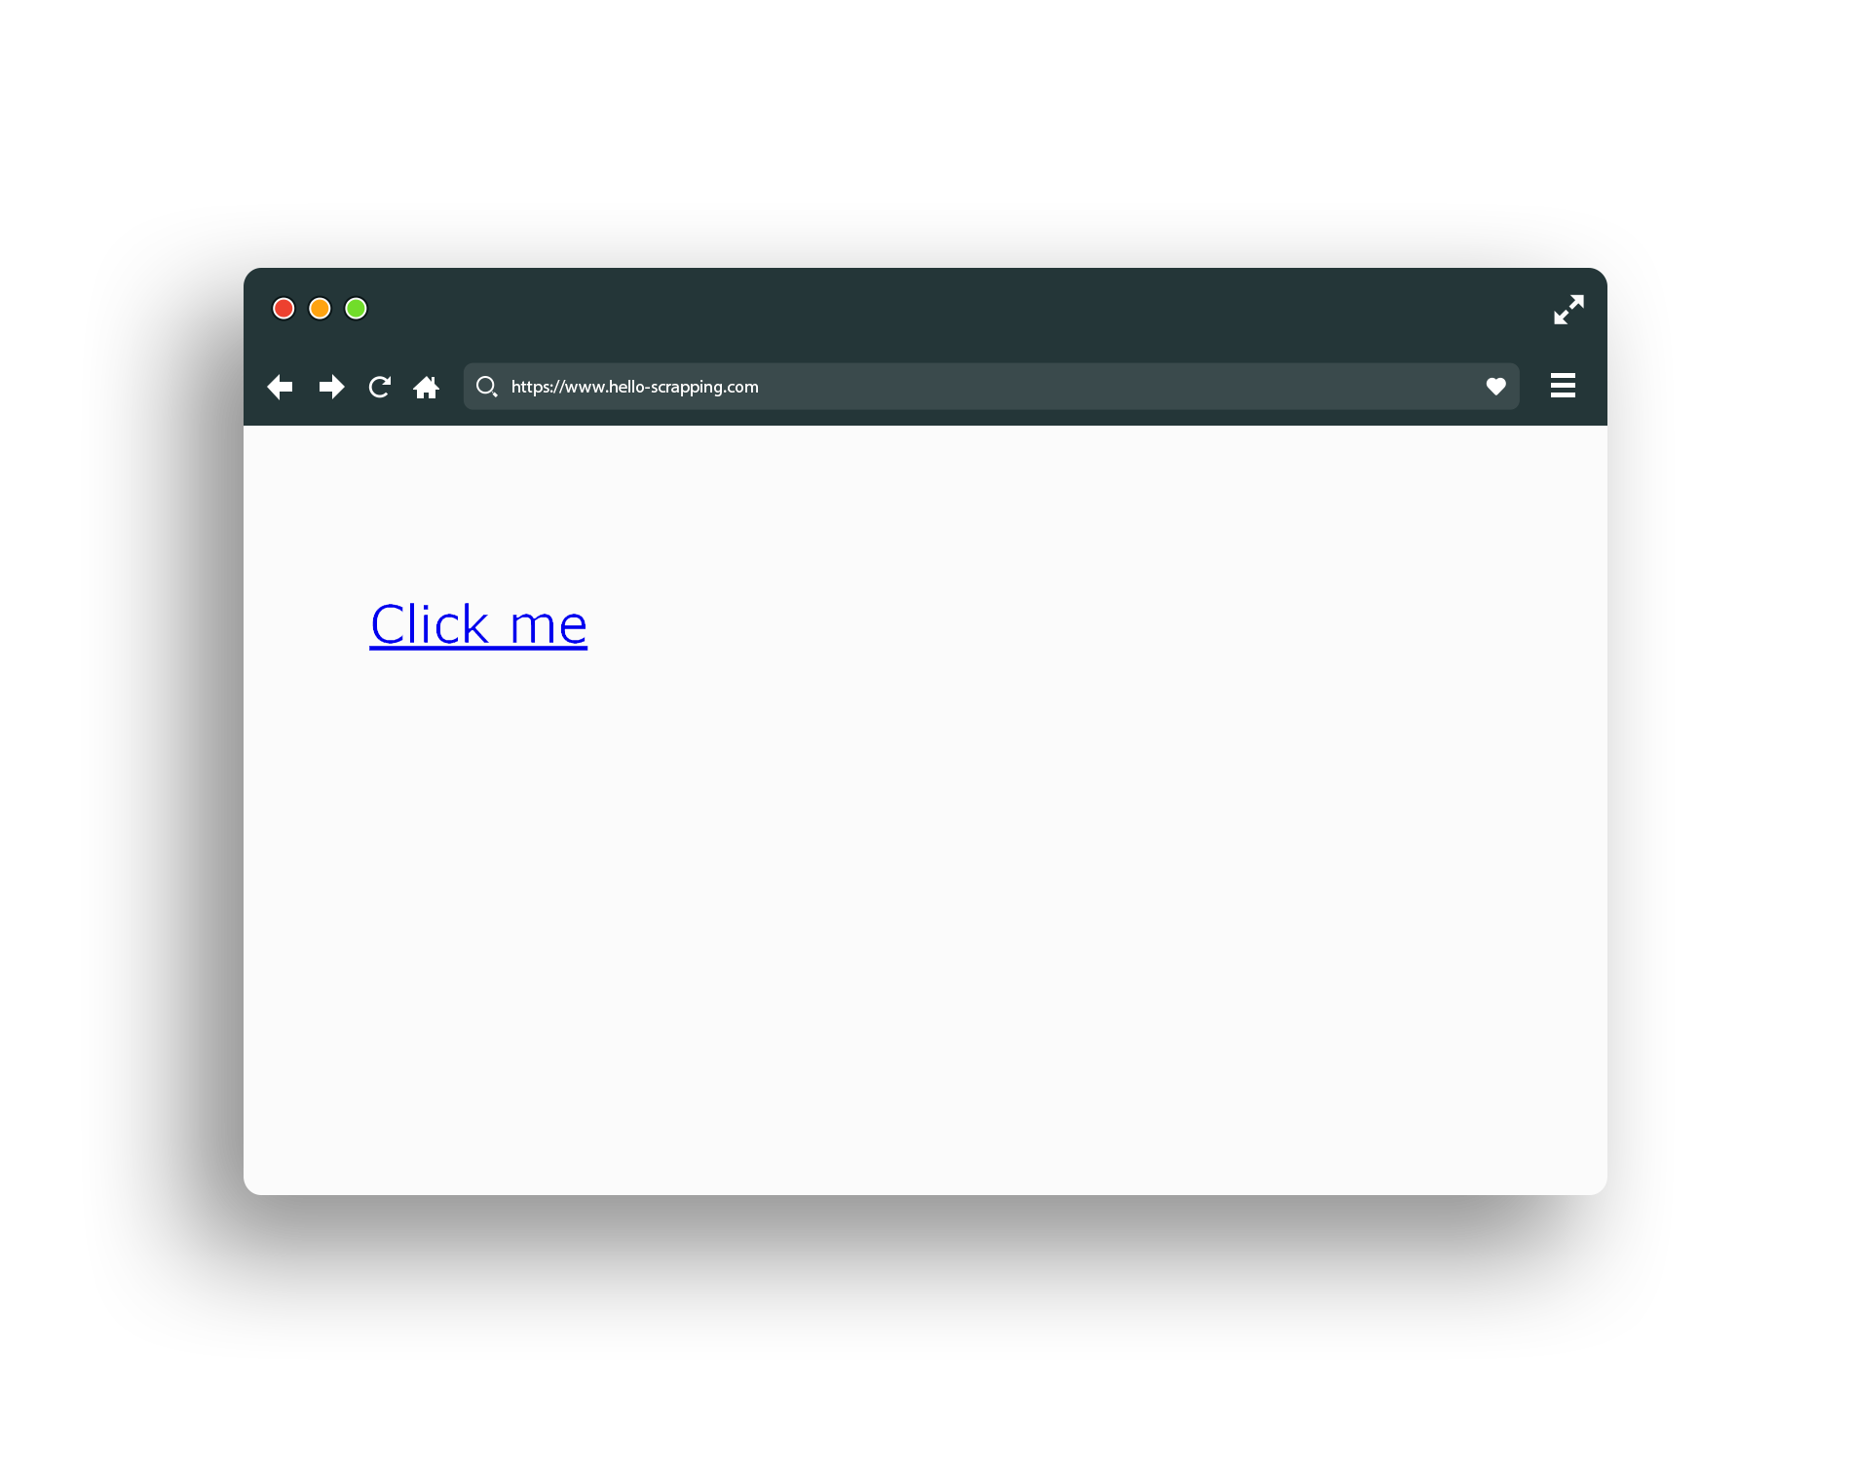
HTML (link)

Slide 36
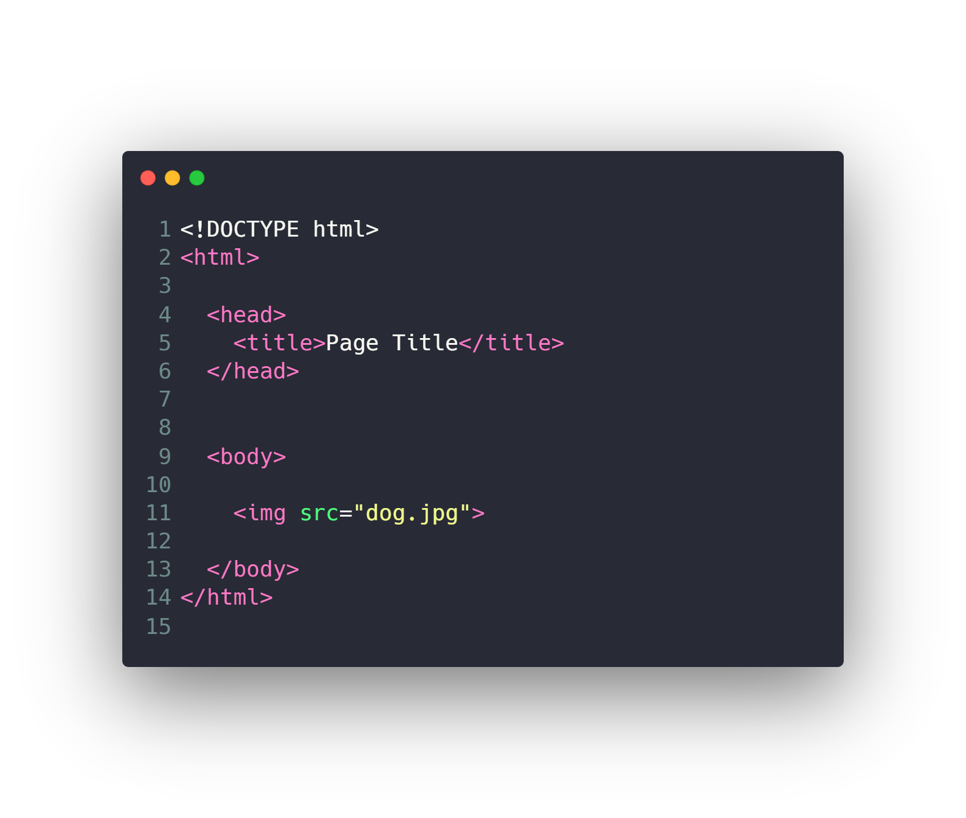
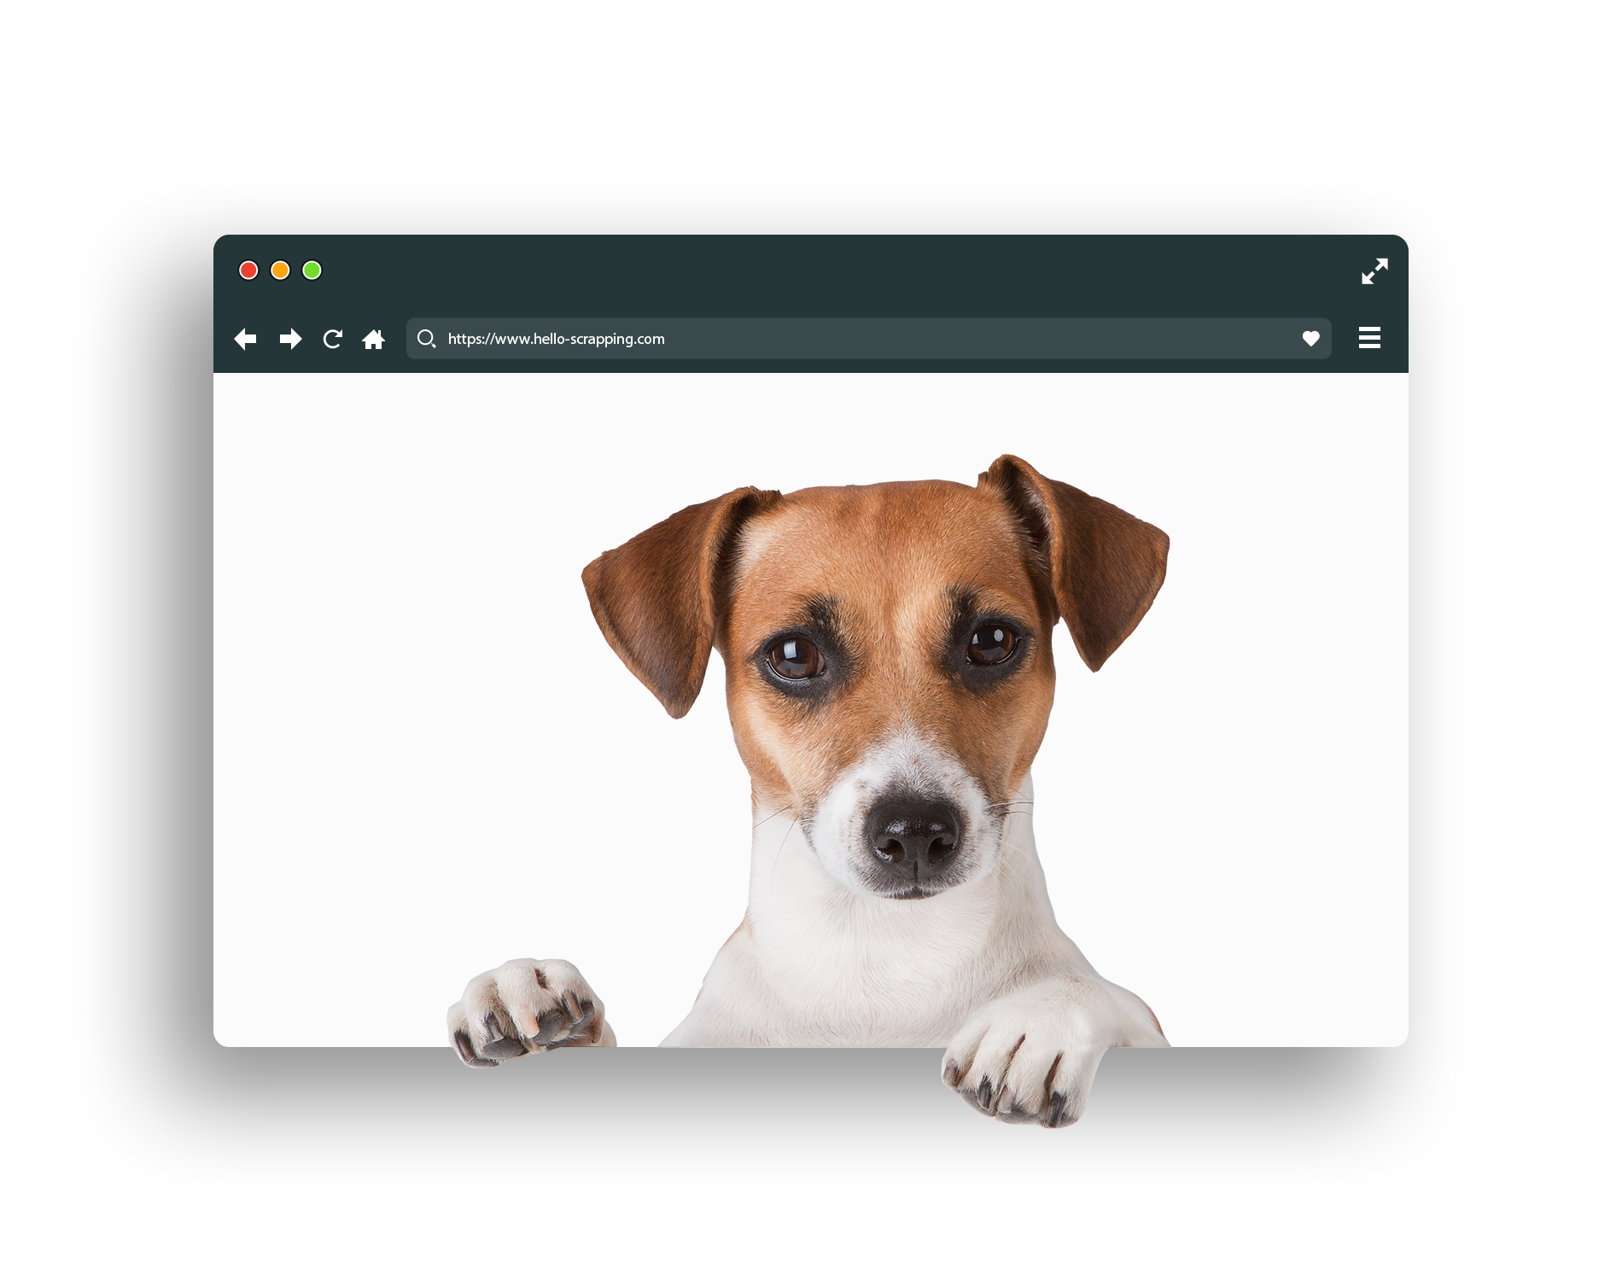
HTML (image)

Slide 37
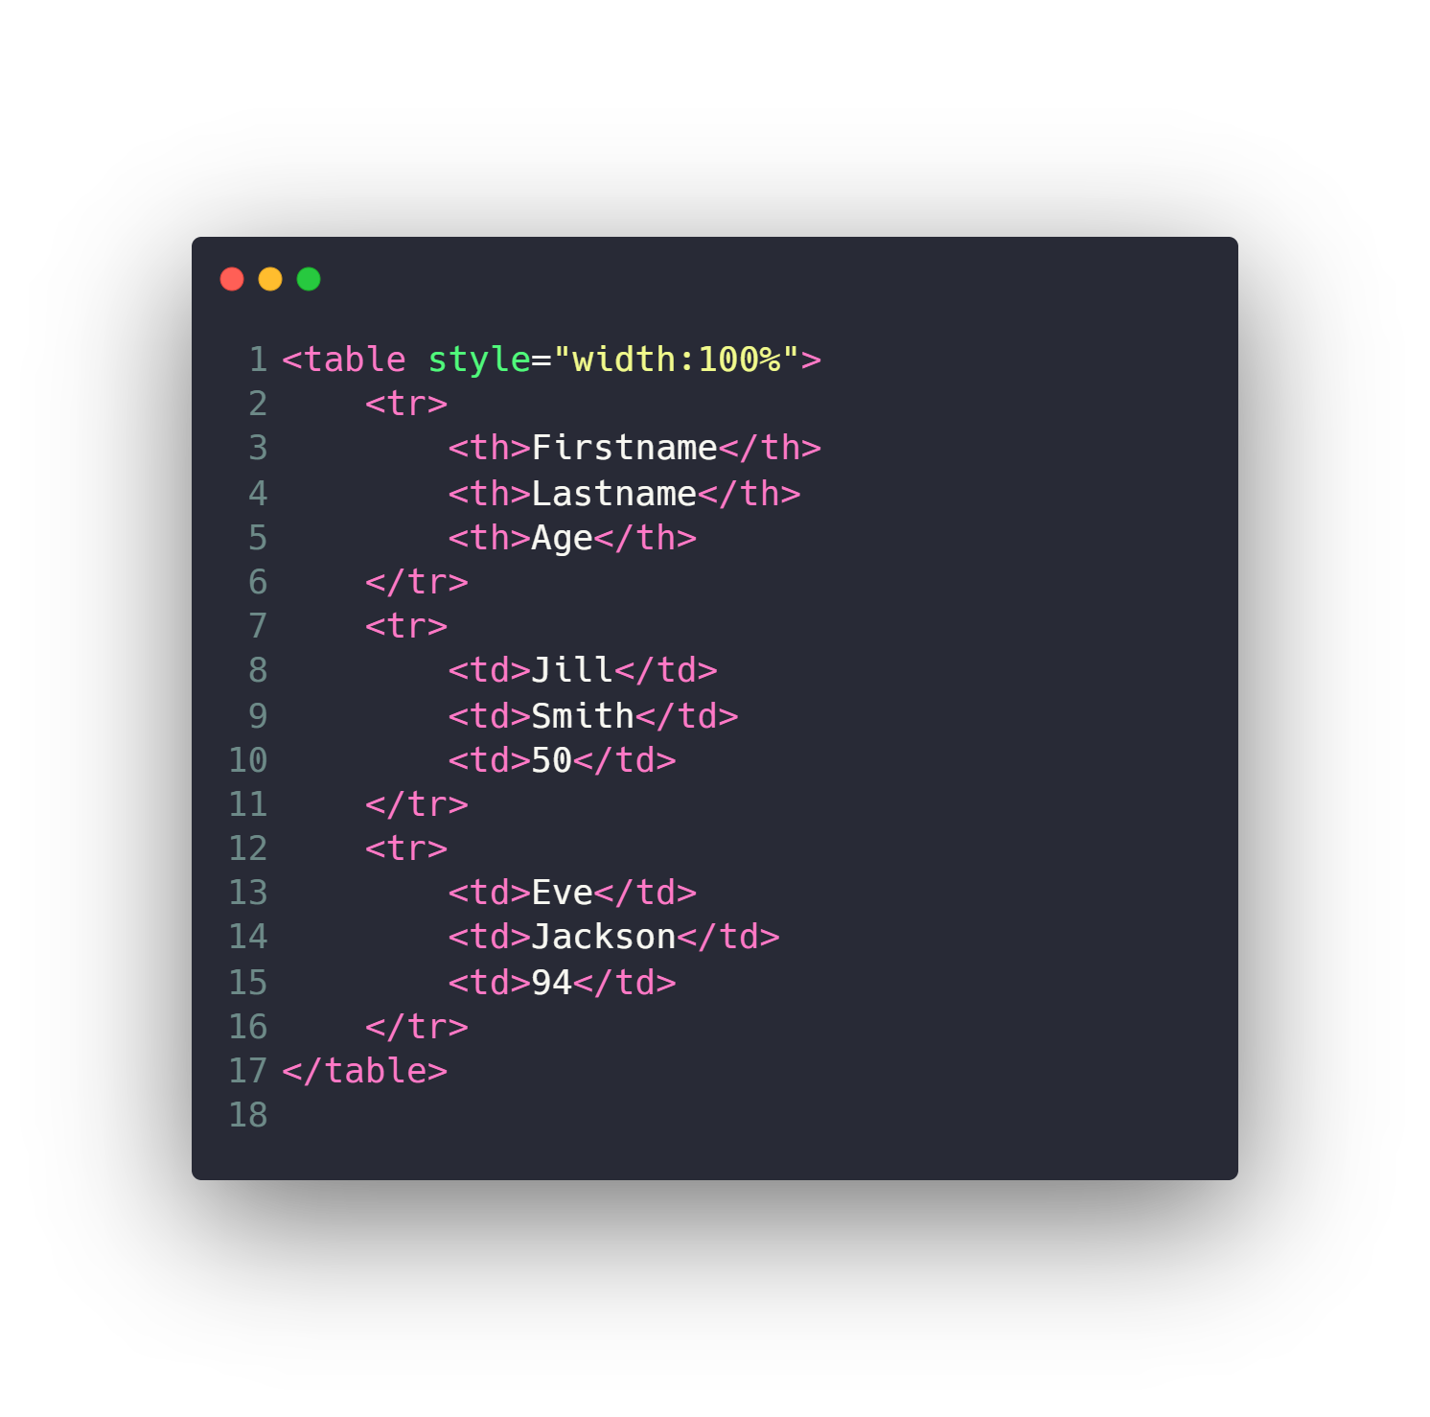
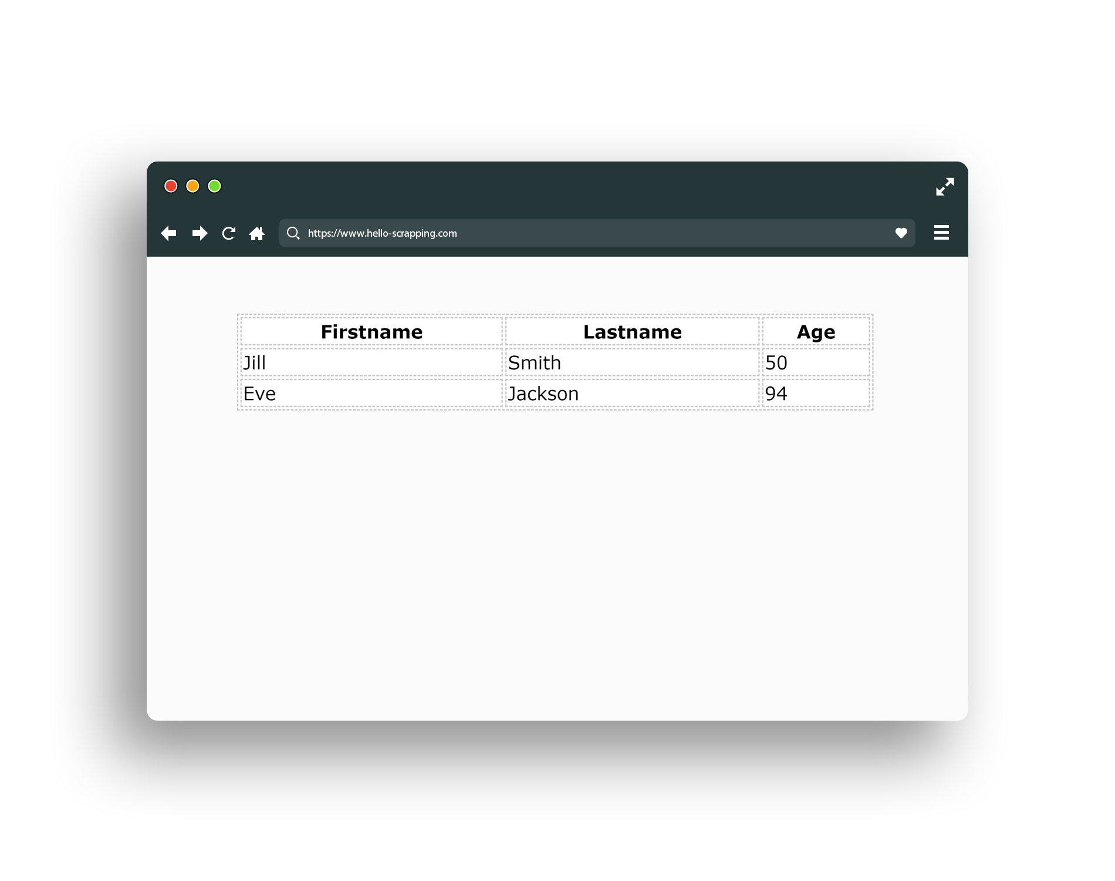
HTML (table)

Slide 38
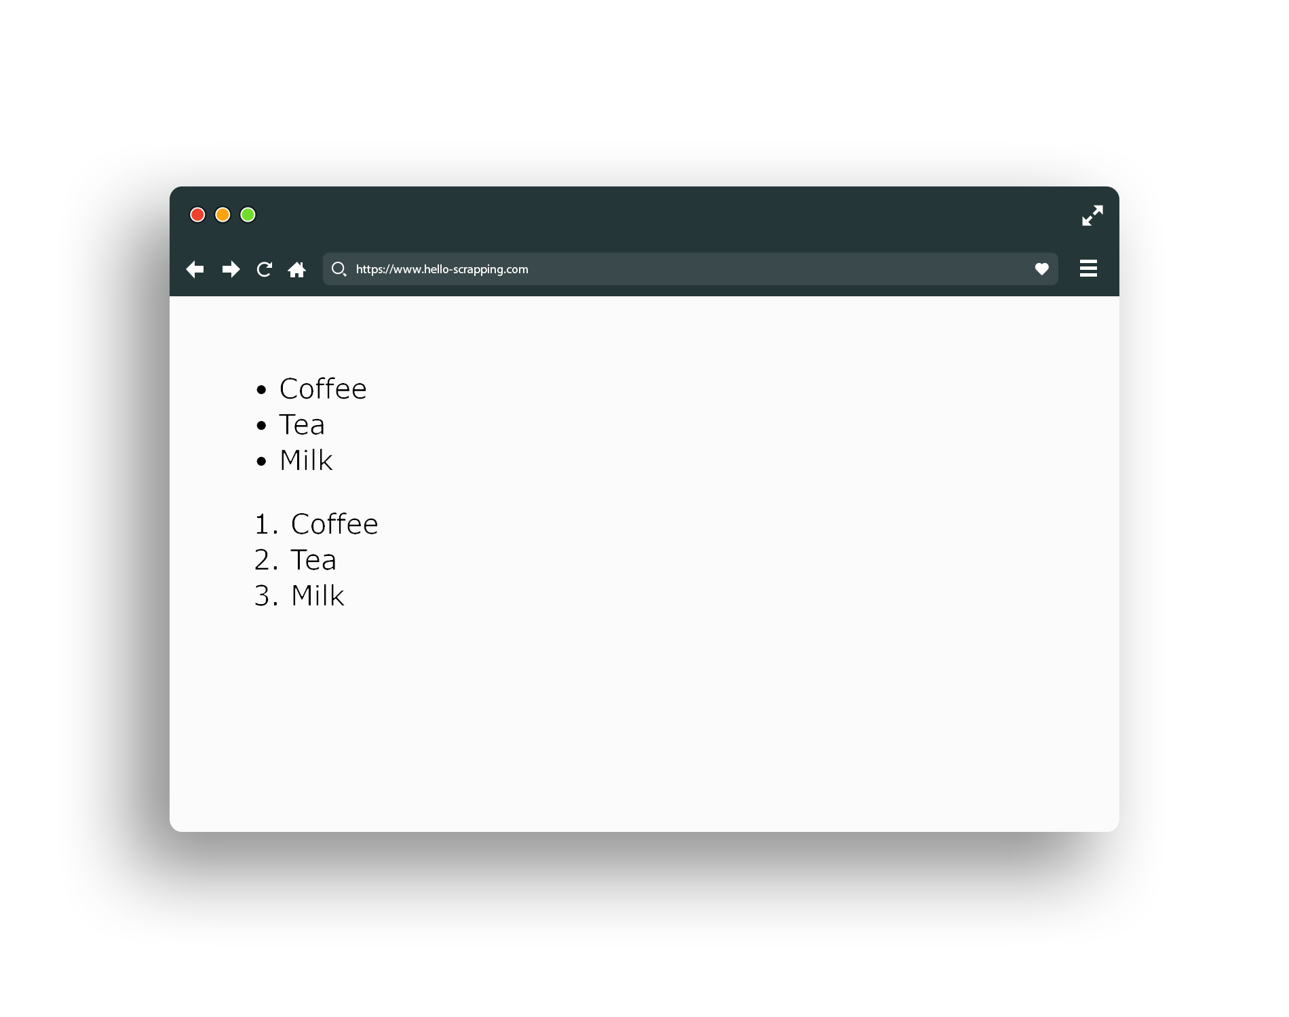
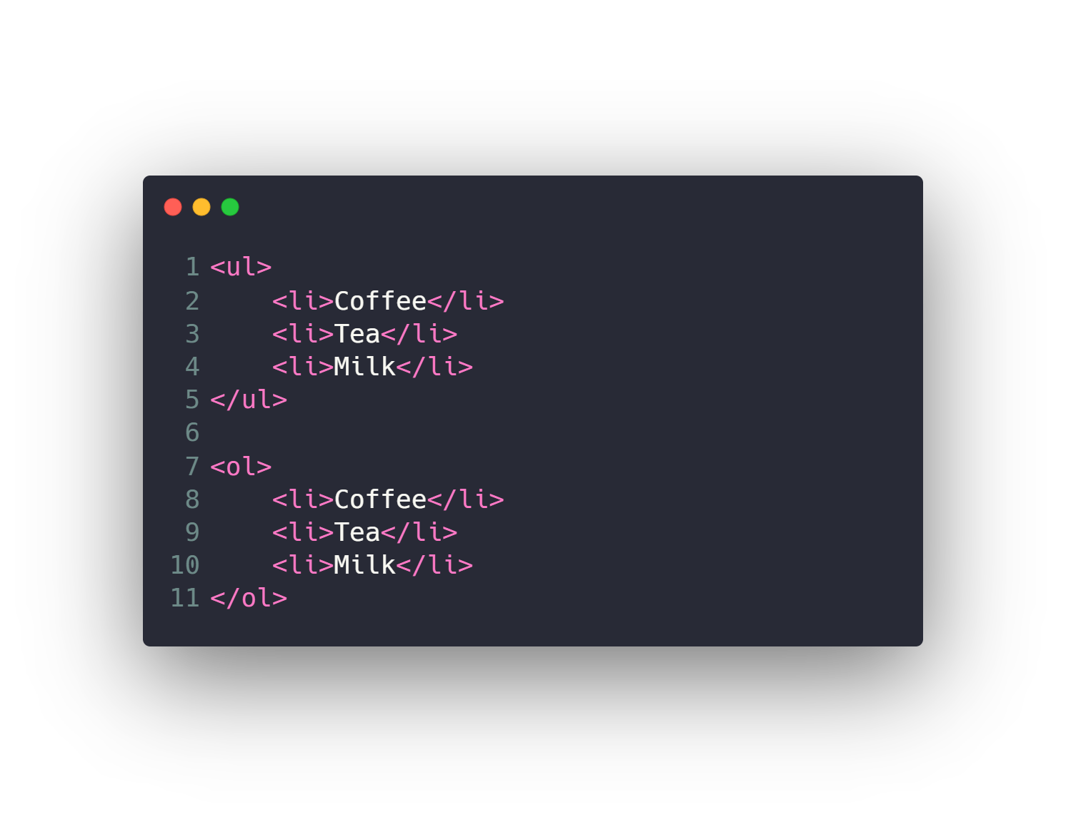
HTML (list)

Slide 39
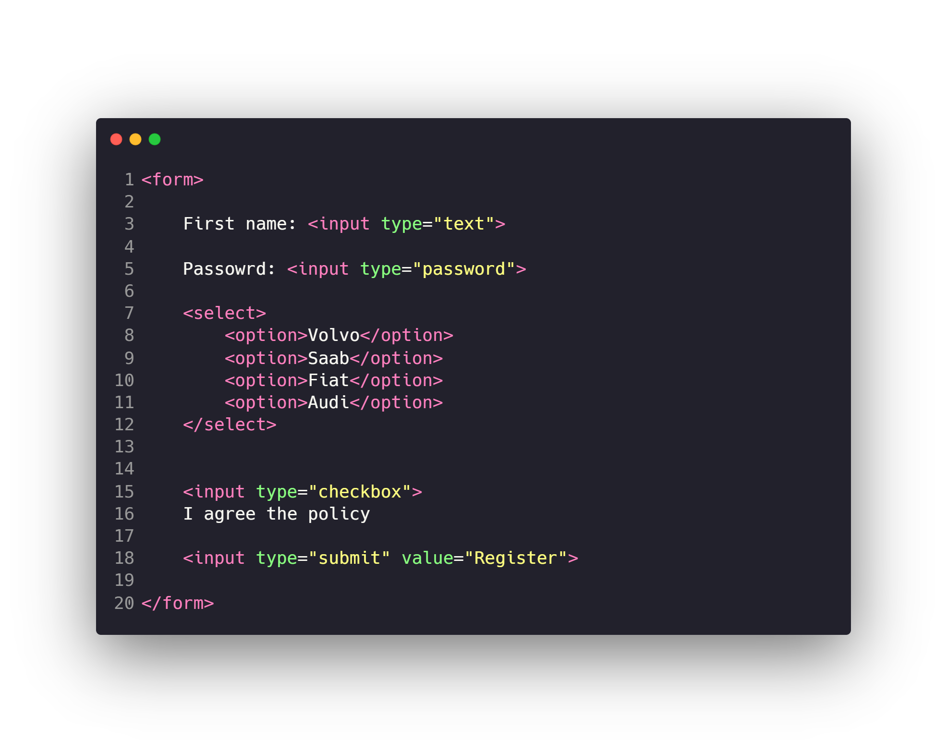
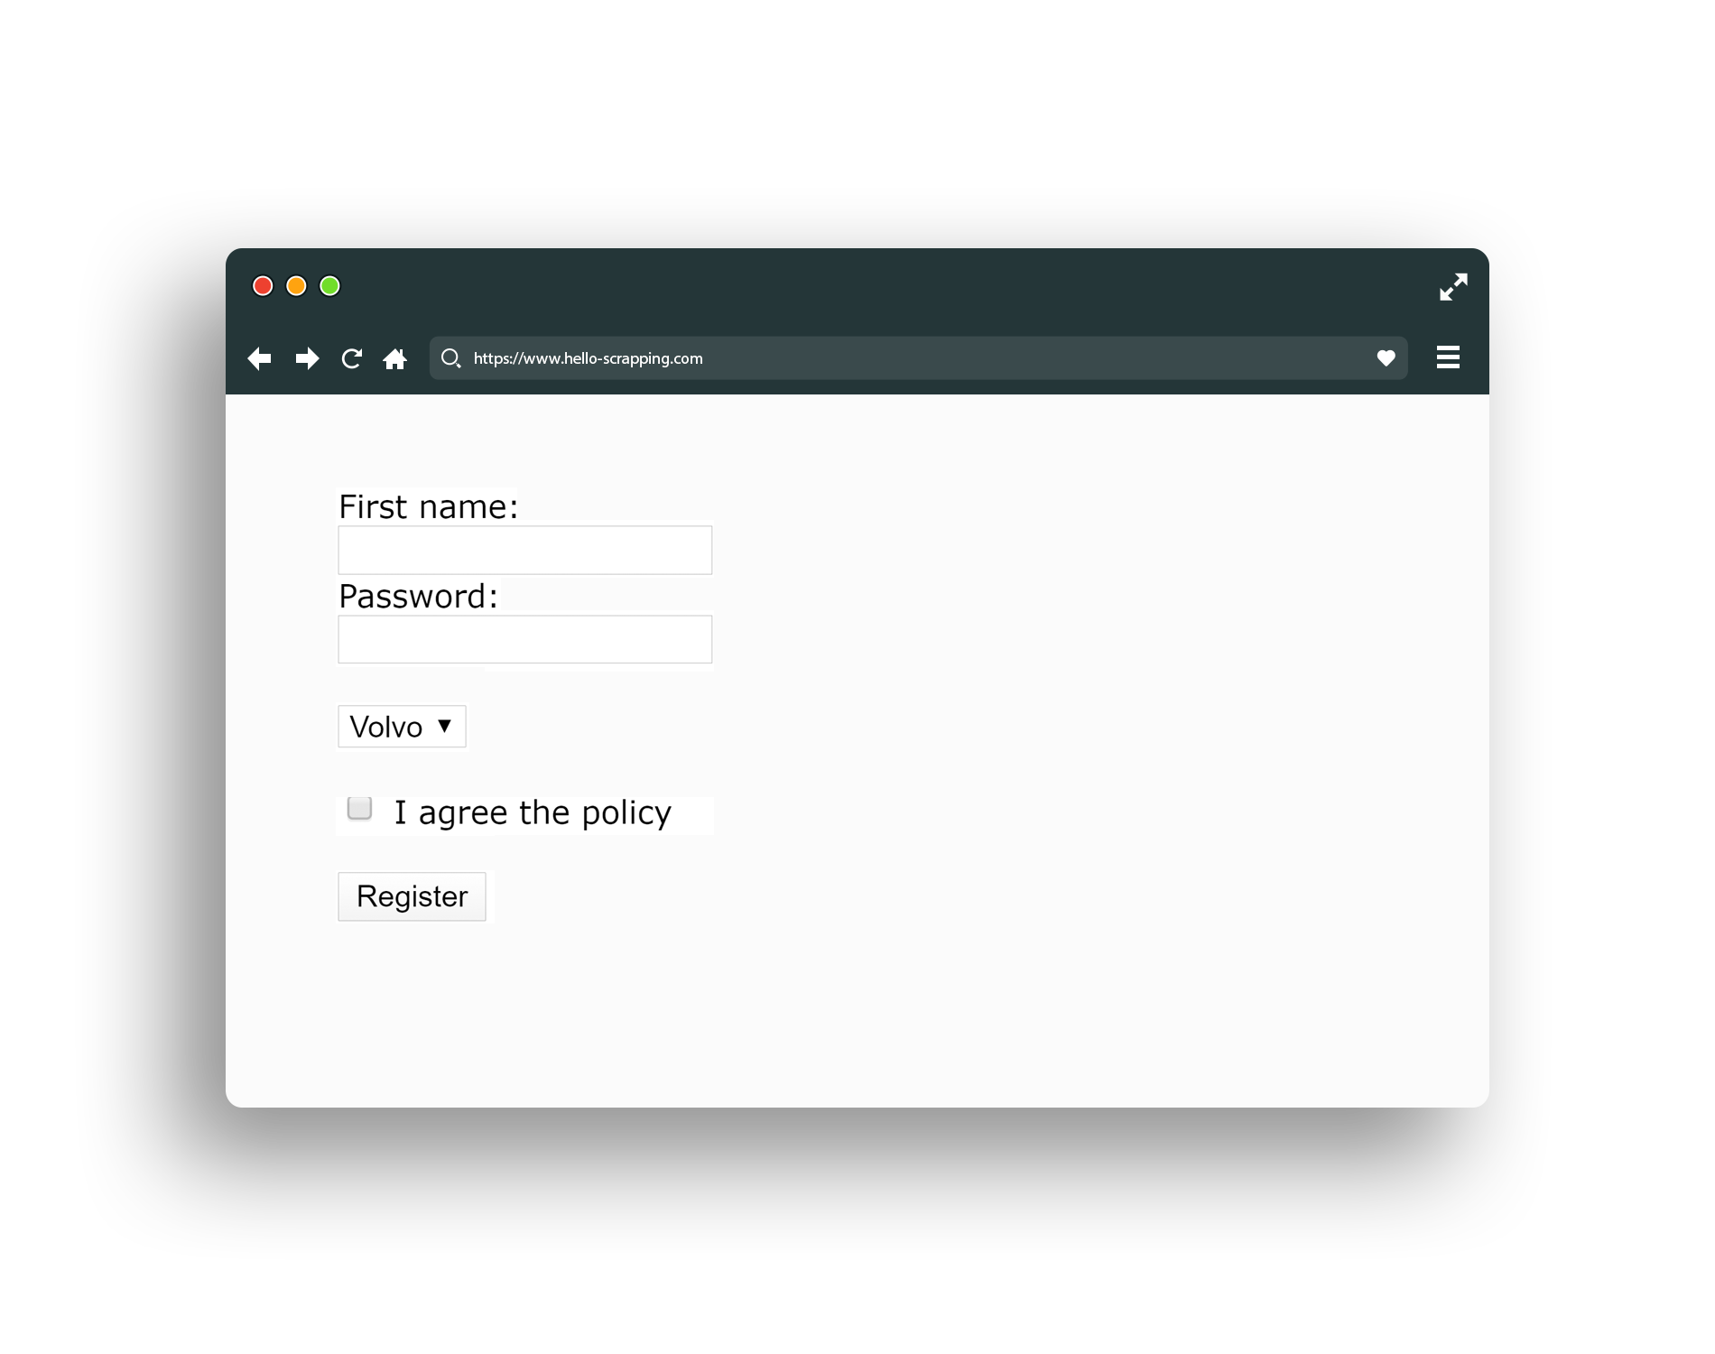
HTML (form)

Slide 40
Other HTML Elements
Div
Span
Video
Audio
Iframe
Header
Footer
Canvas
…

Slide 41
Agenda
What is Internet and Web Servers
HTTP Request/Response Cycle
REST API Web Services
Work with JSON
HTML
CSS
Scrapping Concept
BeautifulSoap Library

Slide 42
. _____________ is a language for creating Web pages.
HTTP
HTML
TTTP
None of the above.

Slide 43

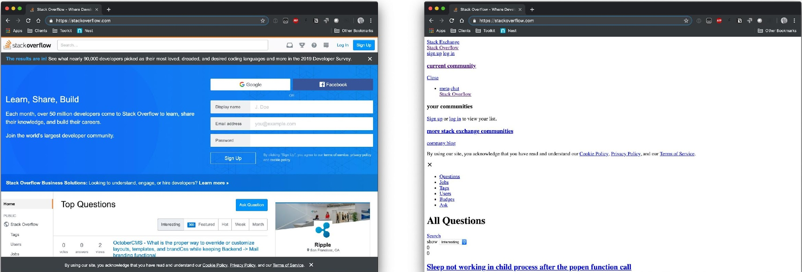
CSS
Cascading Style Sheet
HTML alone is not enough to give us the colorful and beautiful websites we surf everyday, So CSS is responsible for styling HTML
Documents by its own means of Styling

Slide 44
CSS
Text & Fonts
Colors
Backgrounds
Borders
Margin & Padding
Width & Height
Gradient
Shadows
…

Slide 45
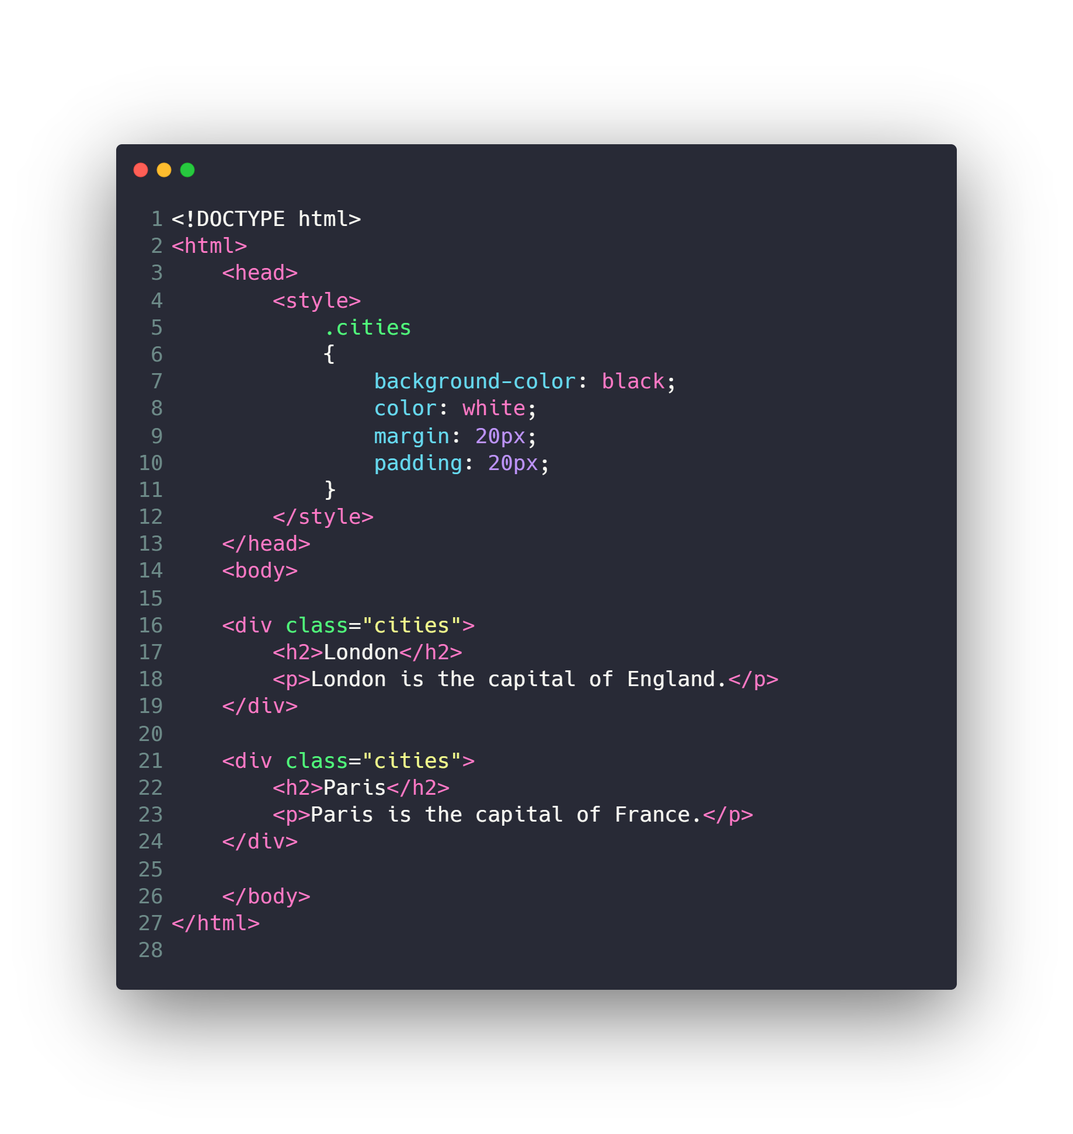
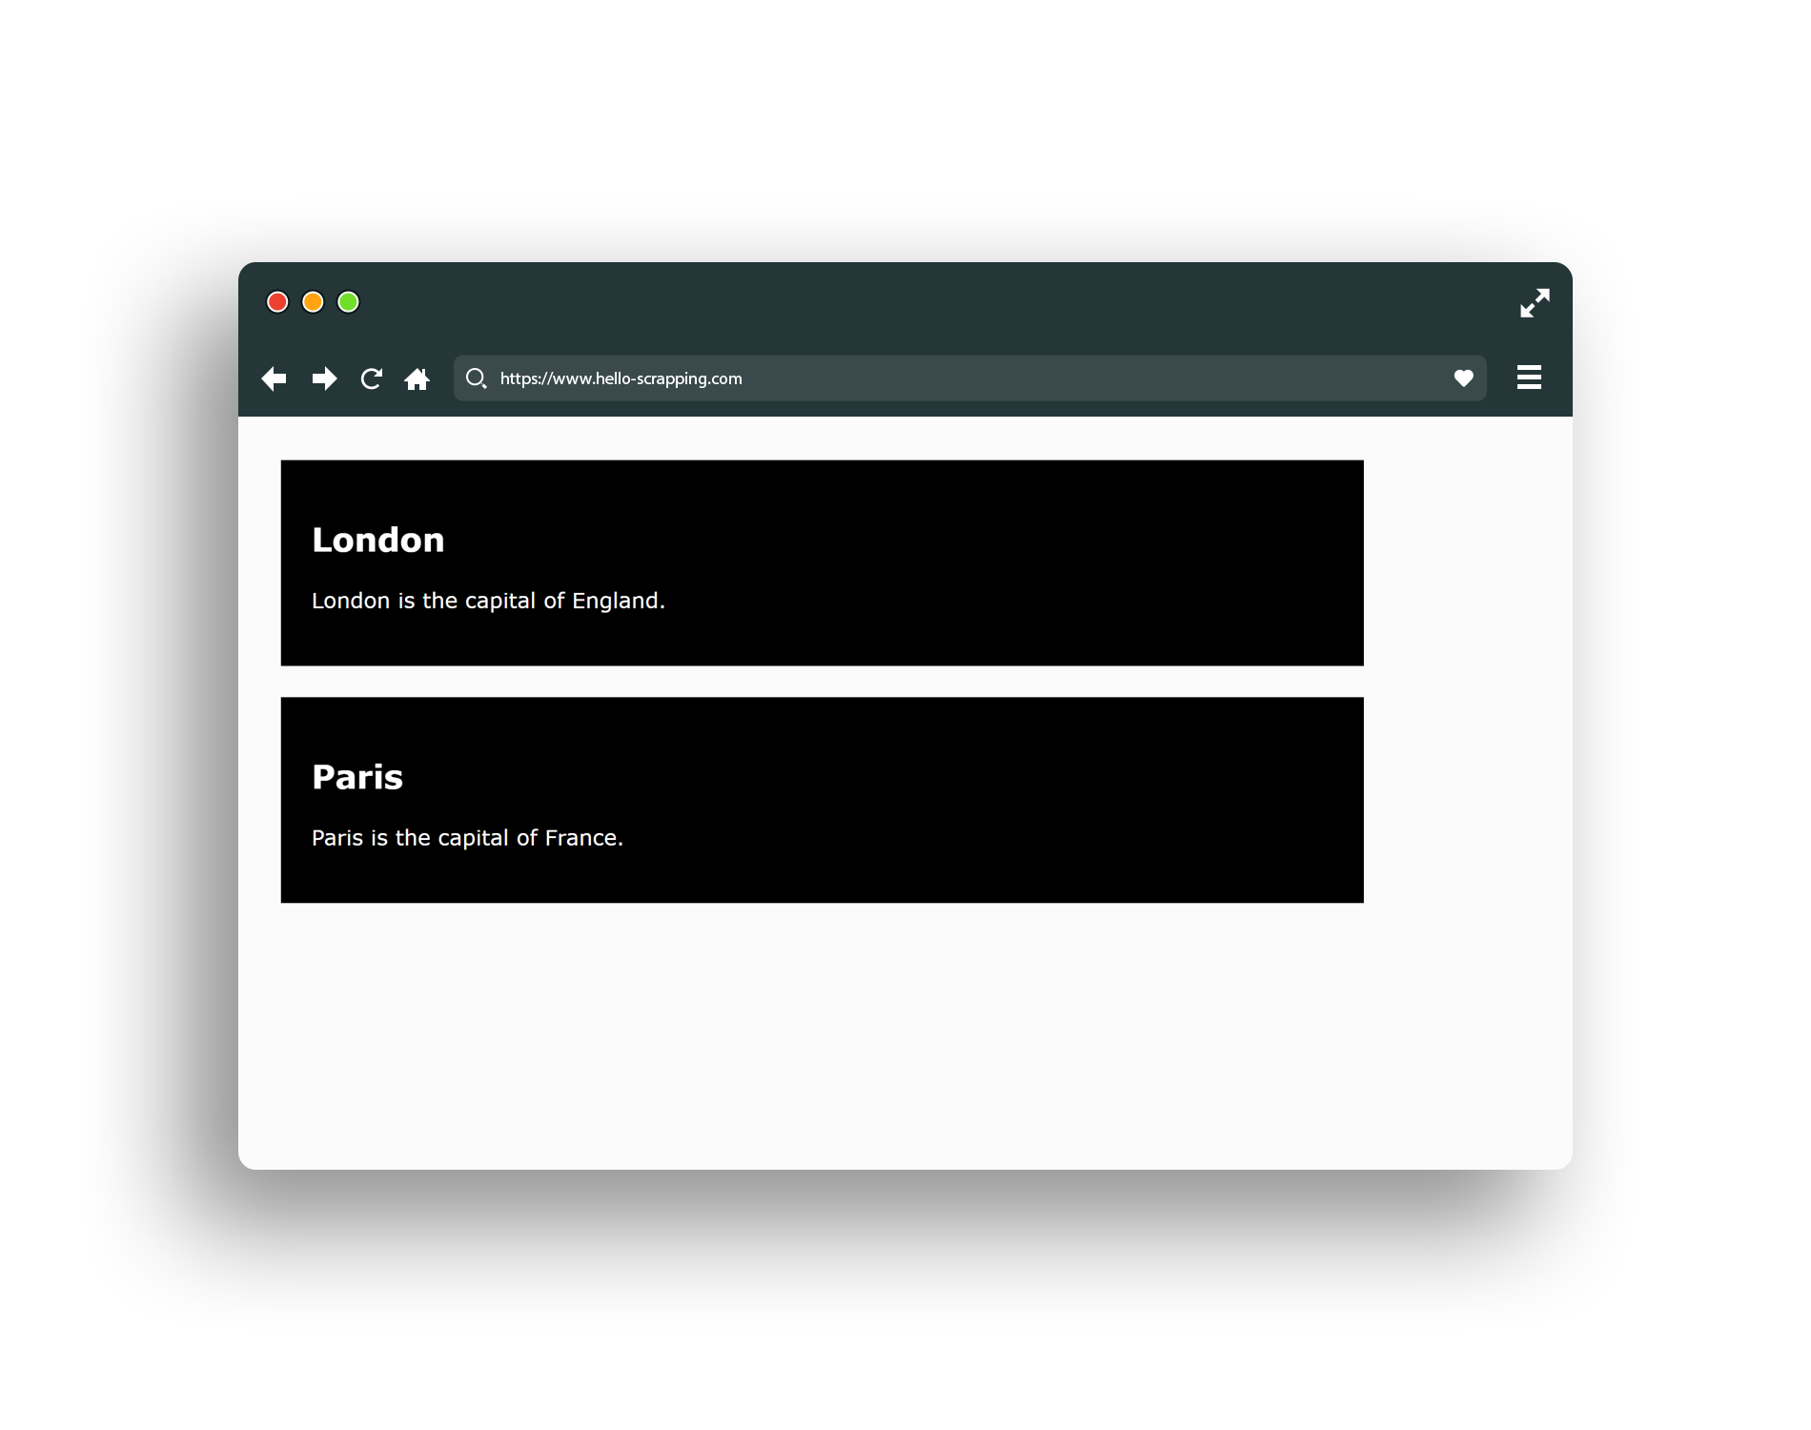
Classes and ID

Slide 46

Check Also
JavaScript
React & Angular
Ajax
Web Sockets
PHP: Laravel
Python: Flask, Django
JavaScript: Node.js
…

Slide 47
For what CSS is used for:
Styling
Building web pages structure
Making pages dynamic
Building functions

Slide 48
Agenda
What is Internet and Web Servers
HTTP Request/Response Cycle
REST API Web Services
Work with JSON
HTML
CSS
Scrapping Concept
BeautifulSoap Library

Slide 49
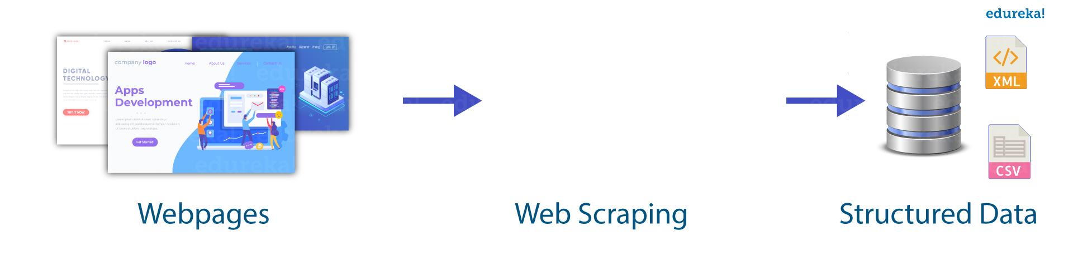
Scrapping Concept
So, what if we are not able to get the data by either getting it collected or through APIs ?!!
We somehow do something called Web Scrapping
YES, We scrape the content of the website by some means of scrapping tools to get the data needed

Slide 50
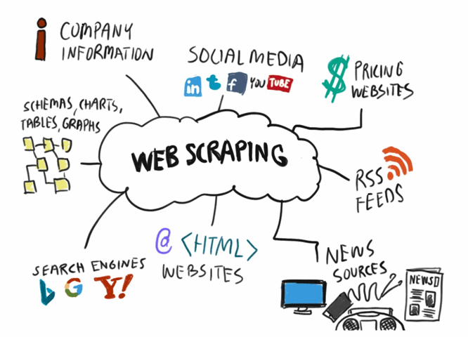
Scrapping Concept
So how the process is done ?!! We use a tool for scrapping then we target a website.
But first we do some investigation to the HTML tags used in that site and do some search to get the target data and where they’re positioned inside the HTML tags.
Then we extract that data by some professional means and THAT’S IT

Slide 51
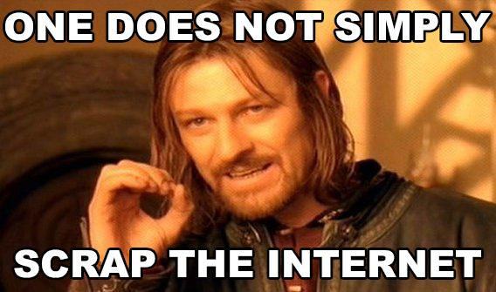
Scrapping Concept

Slide 52
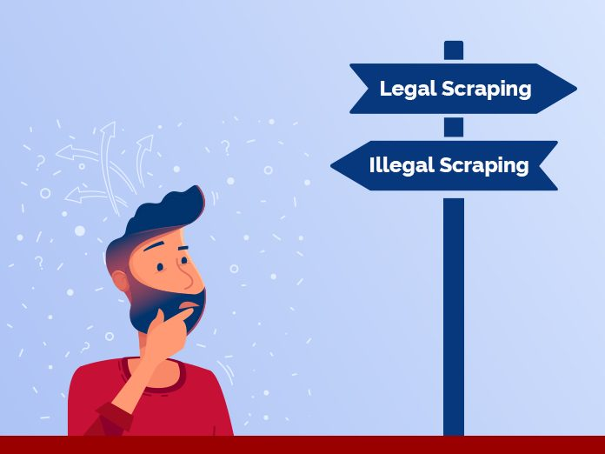
Consider when scrapping :
Types of data:
Public data: perfectly legal.
Private or personal data
Copyrighted data
Website Terms of Service (ToS)

Slide 53
What protocol can be used to retrieve web pages using python?
A. urllib
B. bs4
C. HTTP
D. GET

Slide 54
Agenda
What is Internet and Web Servers
HTTP Request/Response Cycle
REST API Web Services
Work with JSON
HTML
CSS
Scrapping Concept
BeautifulSoap Library

Slide 55
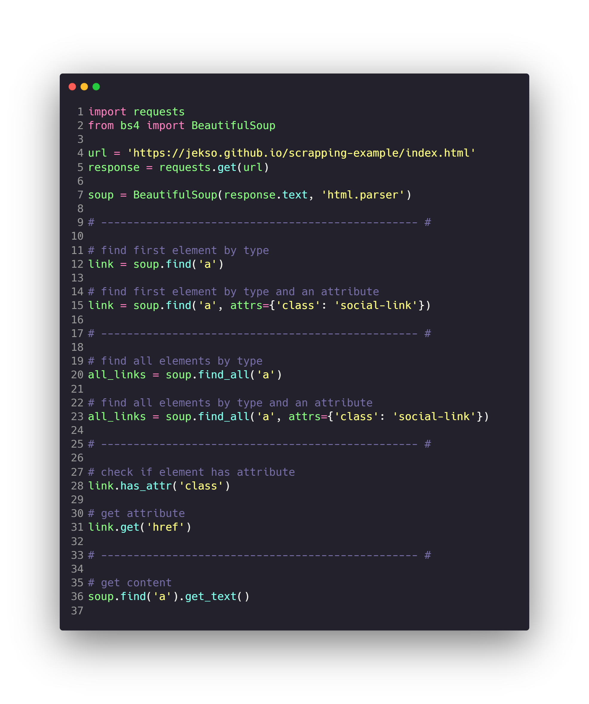
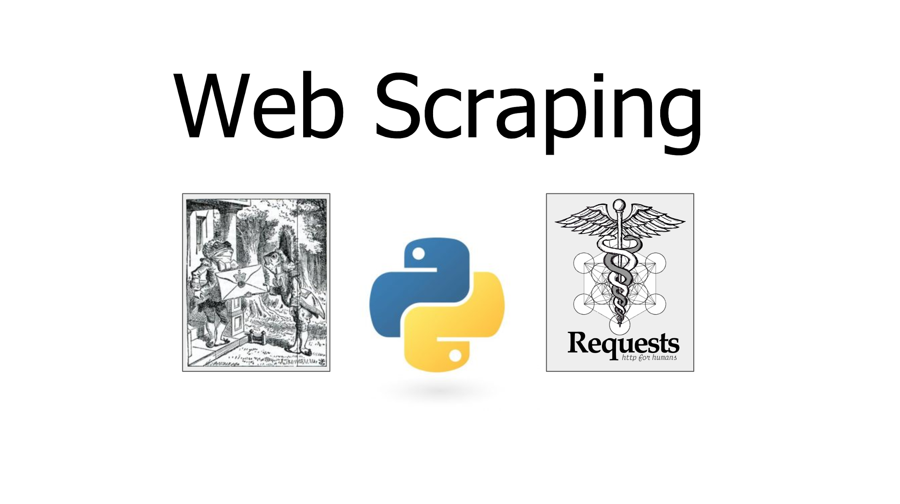
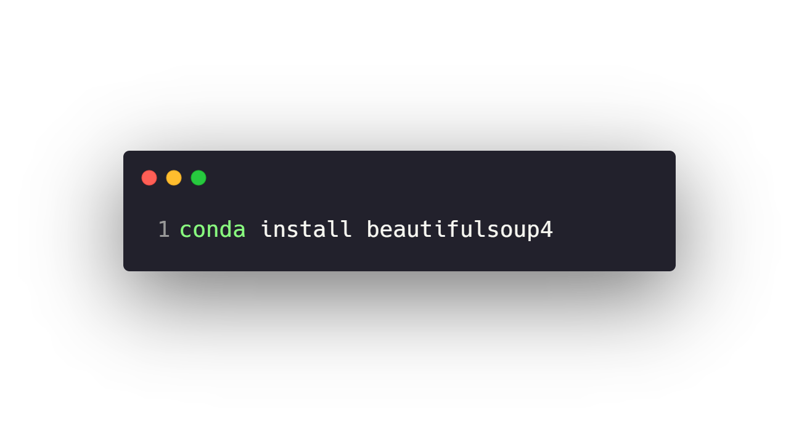
BeautifulSoap Library

Slide 56
Check Also
Other methods to scrap the internet.
https://scrapy.org
https://selenium-python.readthedocs.io
…

Slide 57
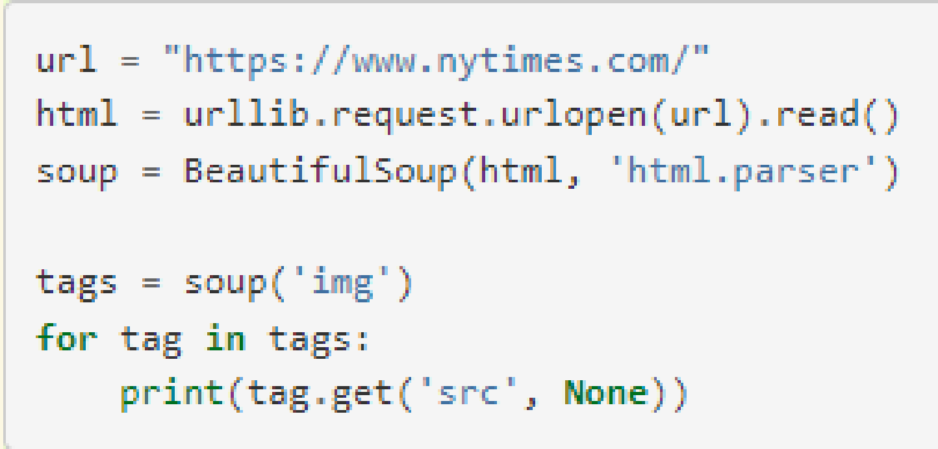
What does the following block of code print?
A. retrieves and displays the webpage
B. downloads the webpage
C. prints the images from 'www.nytimes.com'
D. prints all the 'img' sources under 'src' from 'www.nytimes.com'

Slide 58
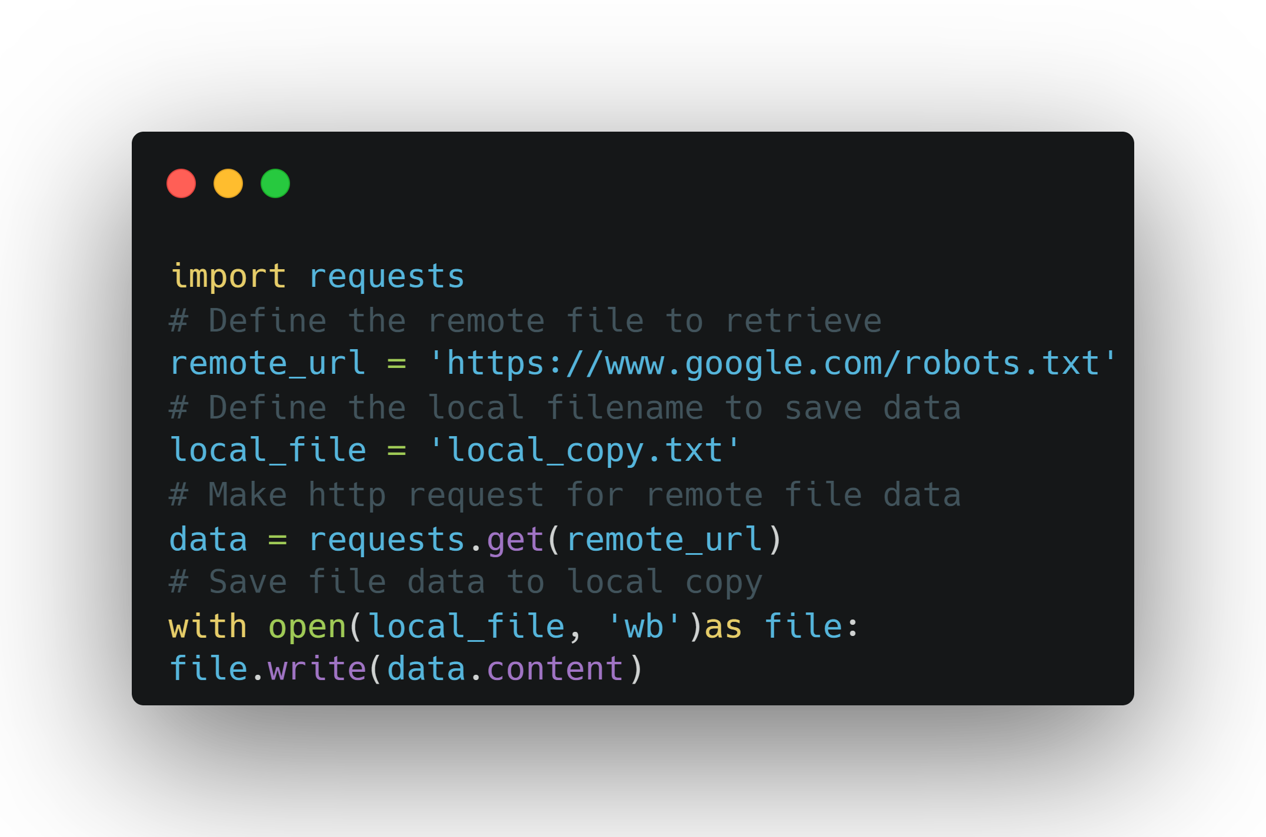
How to download file with python ?
Don't forget to select file extension
1- Find the download link
2- define the path to save file

Slide 59
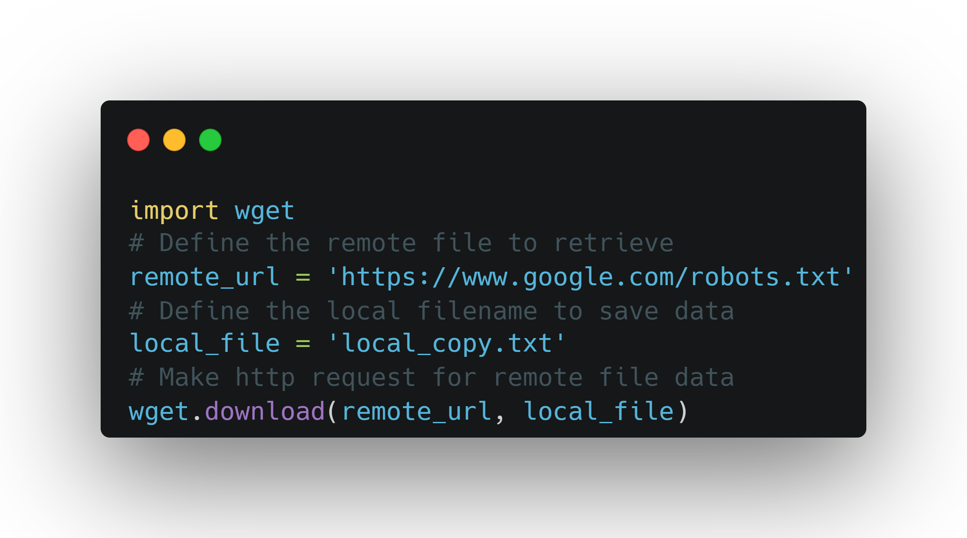
How to download file with python ?
Don't forget to select file extension
1- Find the download link
2- define the path to save file

Slide 60
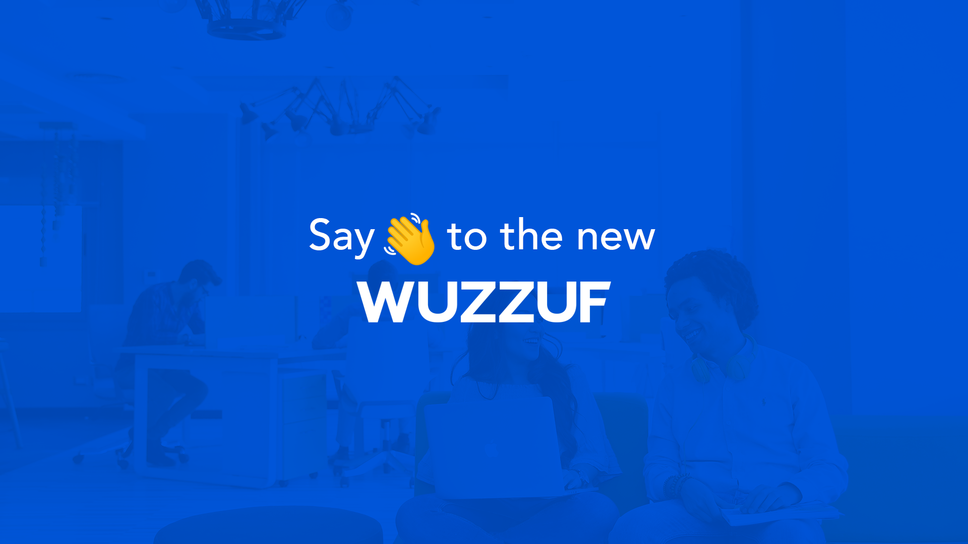
Project 6 – Wuzzuf data collecting

Slide 61
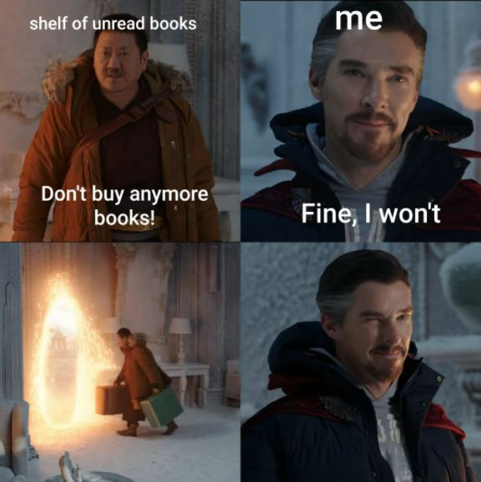
Project 7 – Diwan Books data collecting

Slide 62
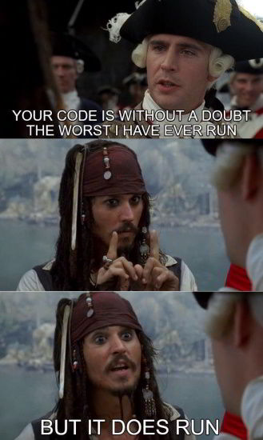

Slide 63
Questions ?!

Slide 64
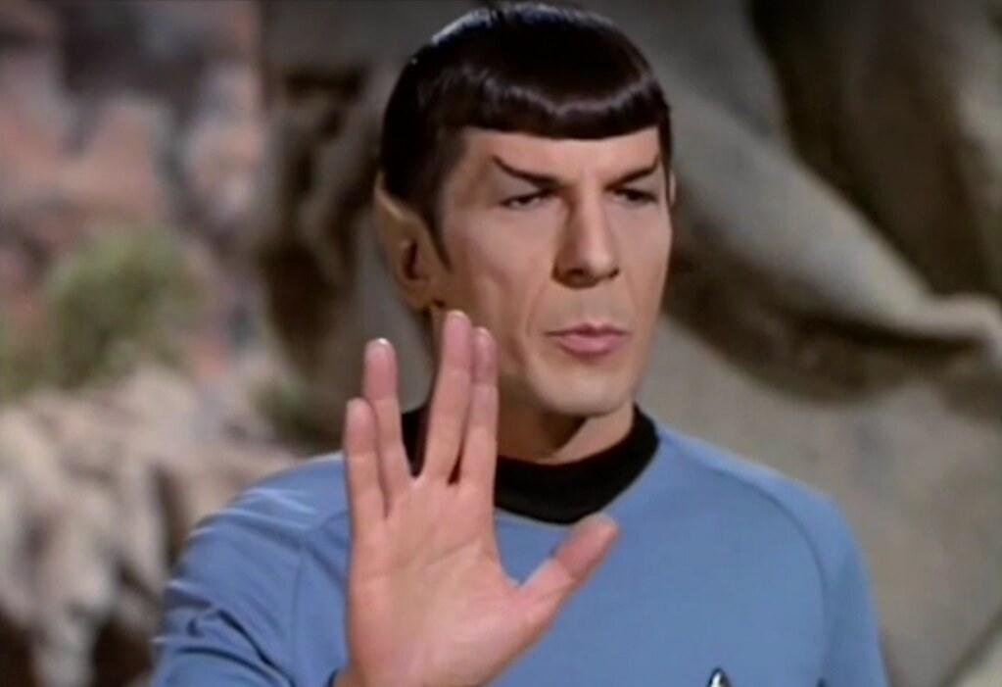
Thanks! >_ Live long and prosper

